Slide 1
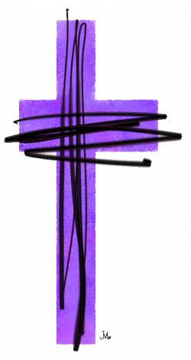

K.3.1 Lent
Lent is a time to prepare for Easter by being good and kind.

Slide 2



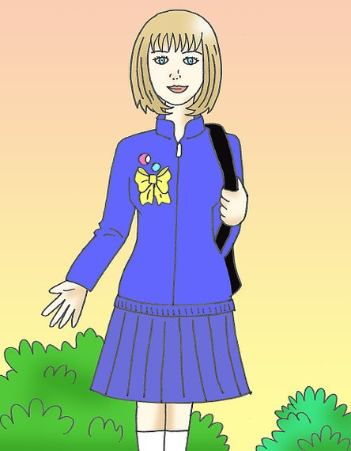


Getting Ready for School

Slide 3




Other Times We Prepare.

Slide 4
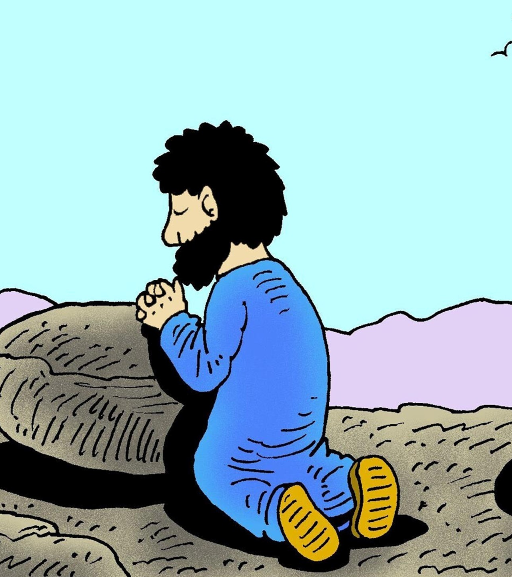
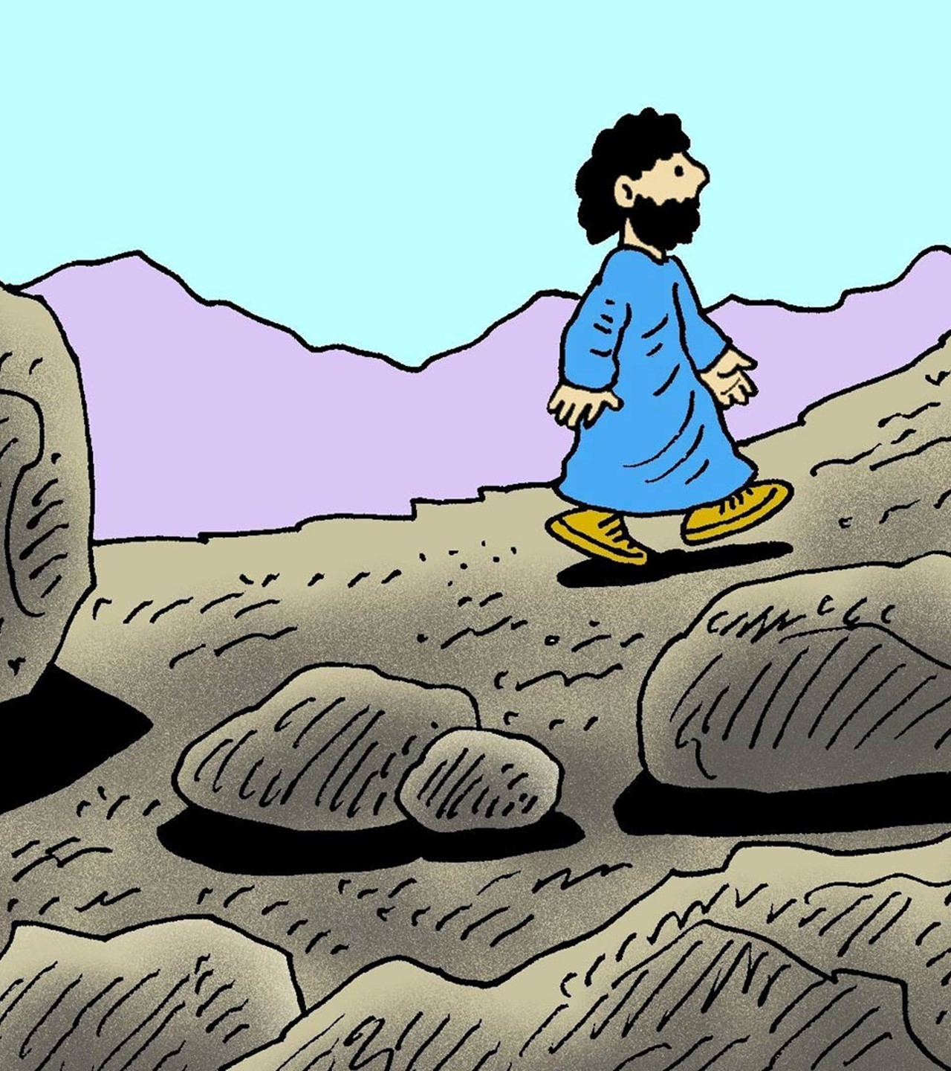
Getting Ready for Easter - Lent

Slide 5
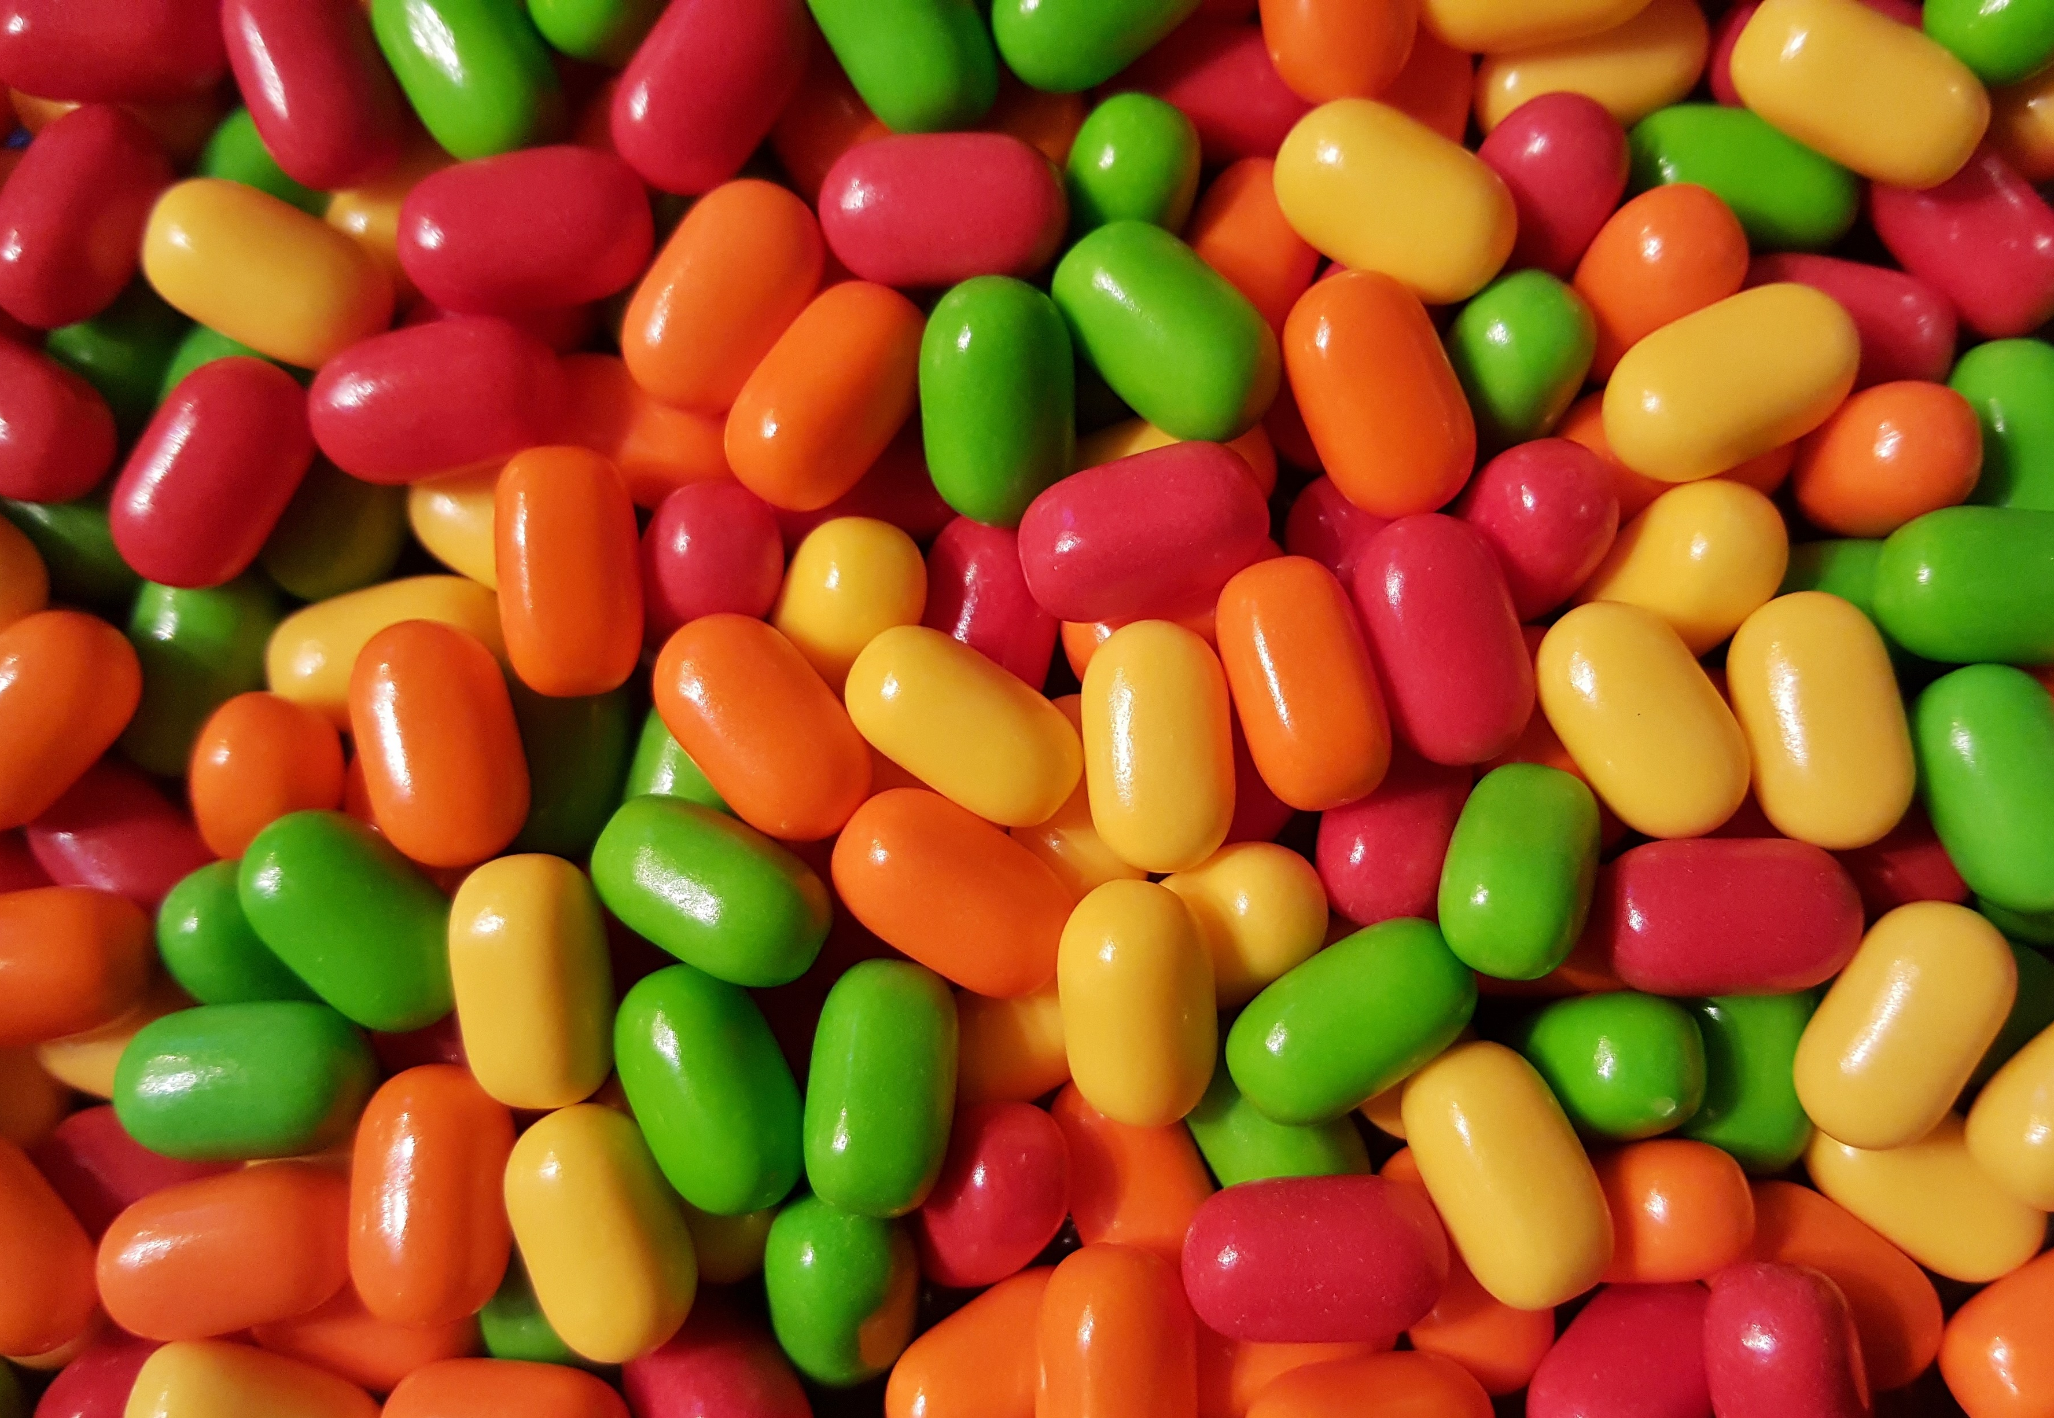
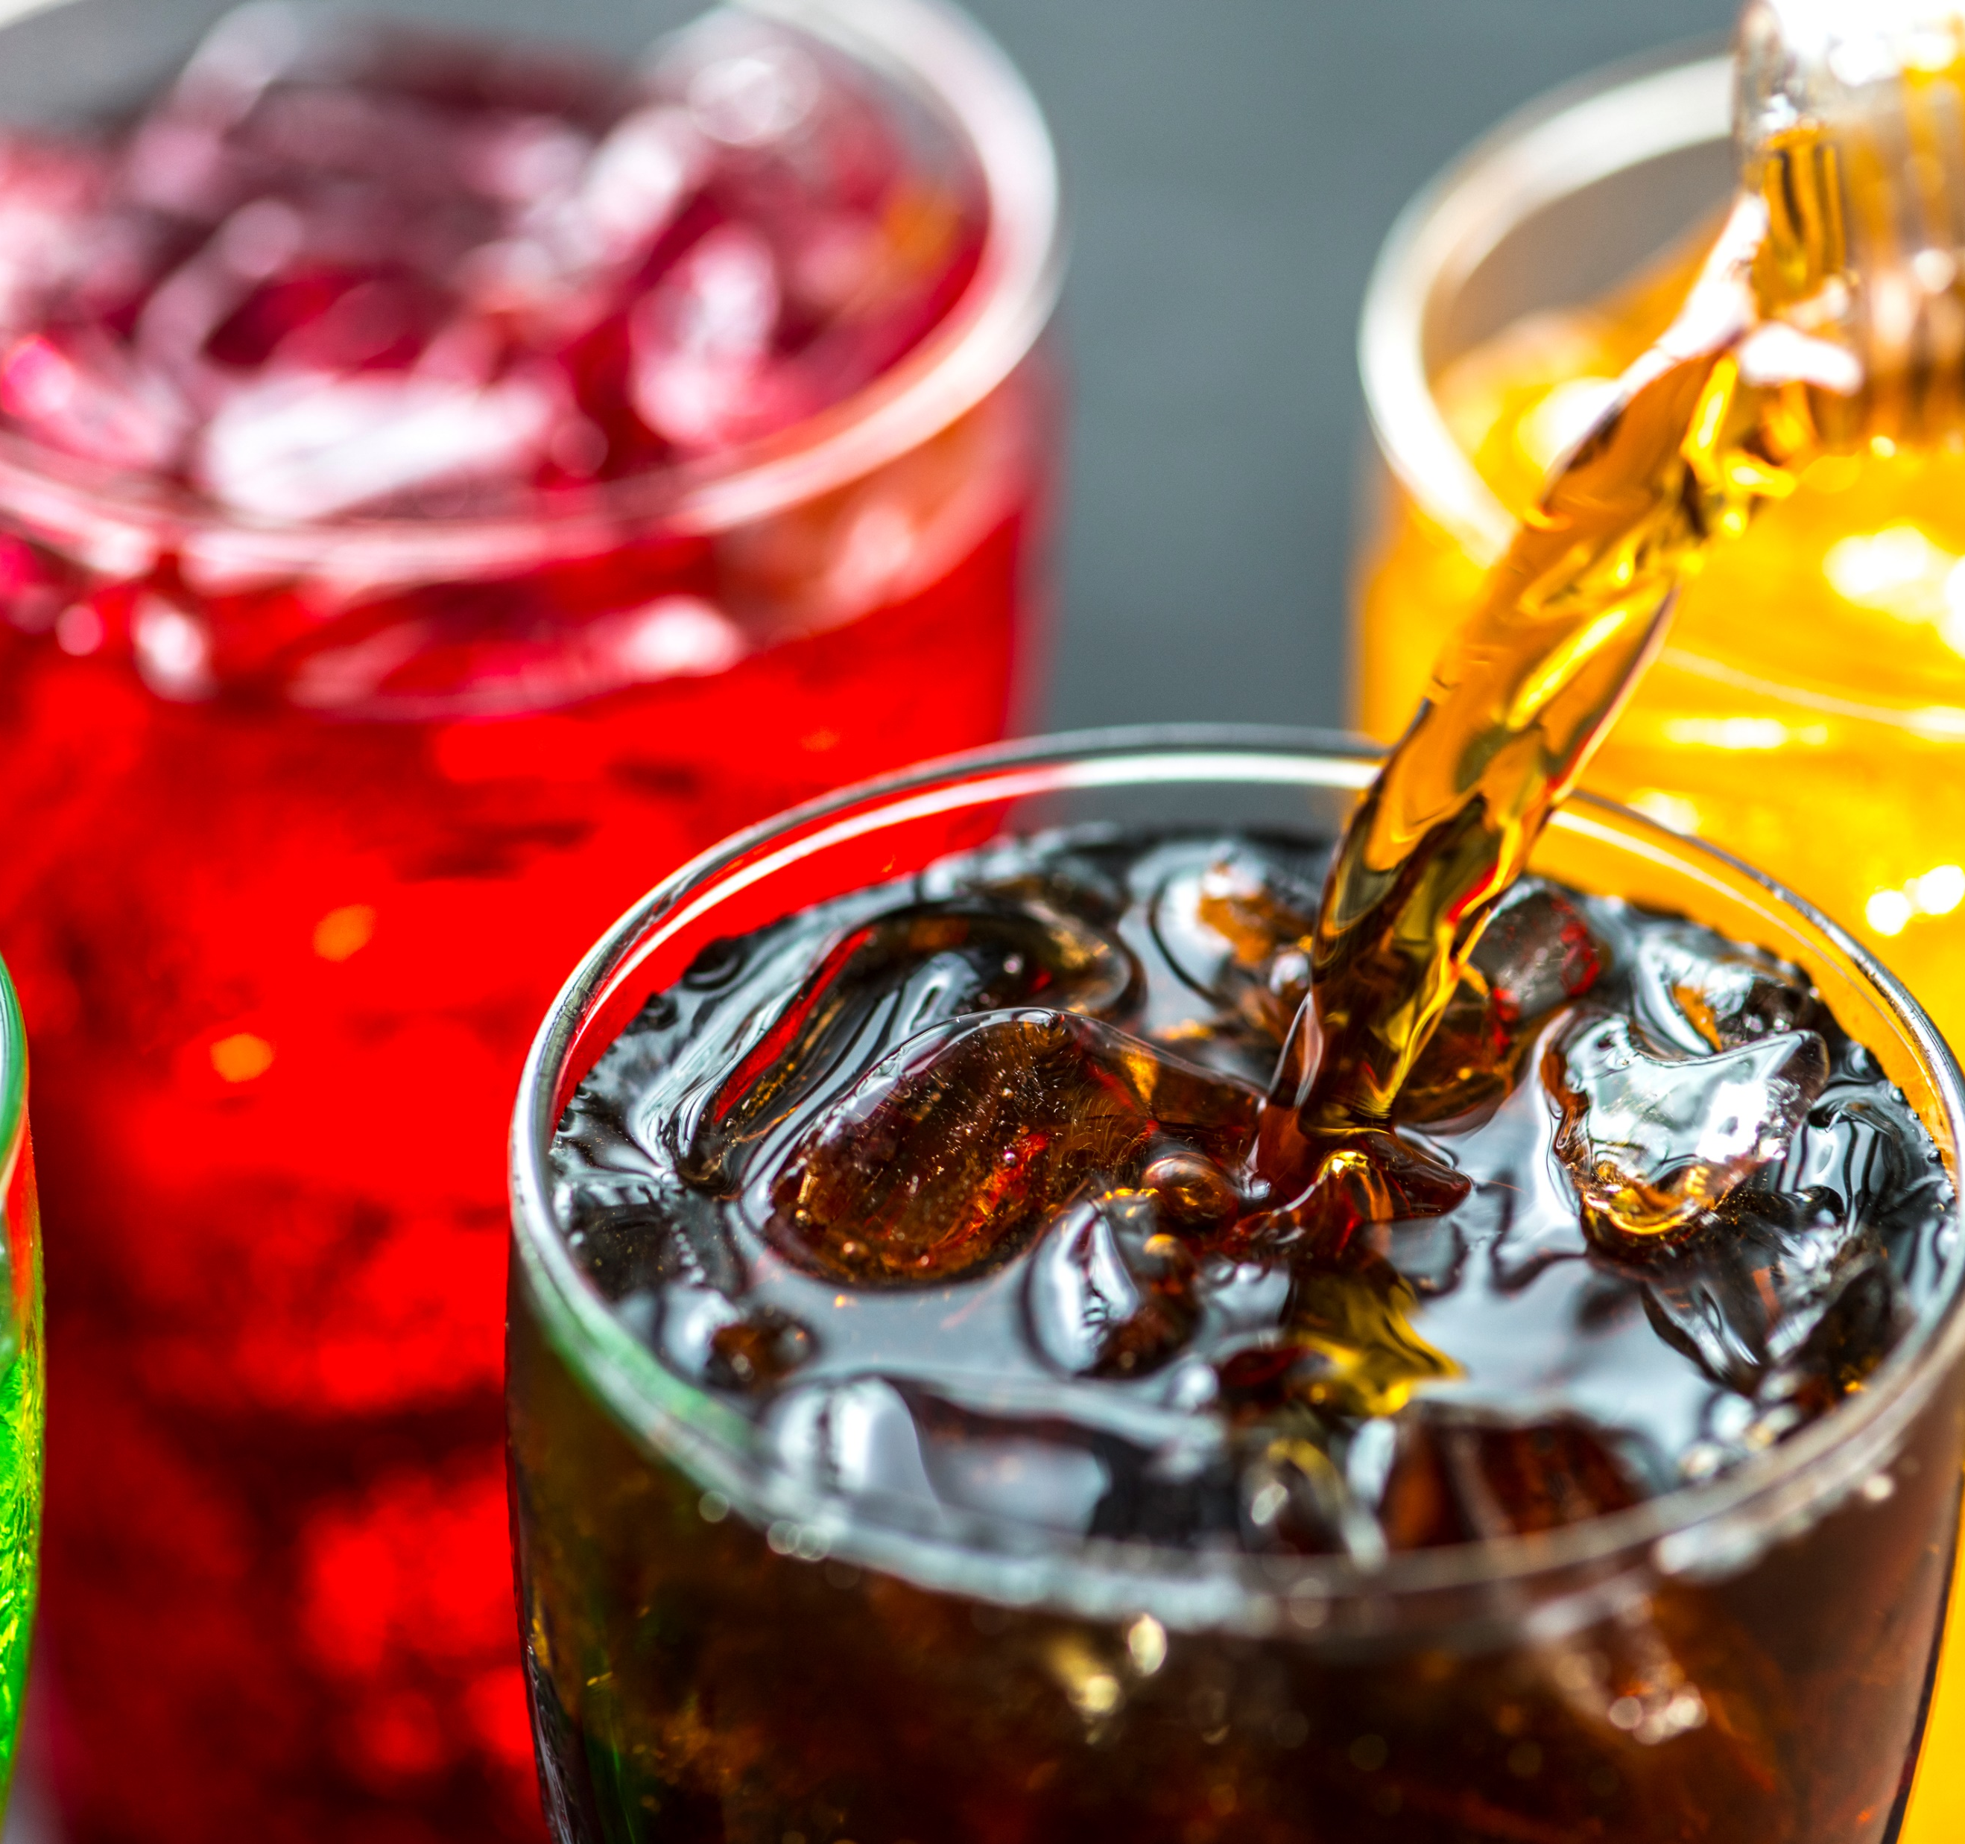
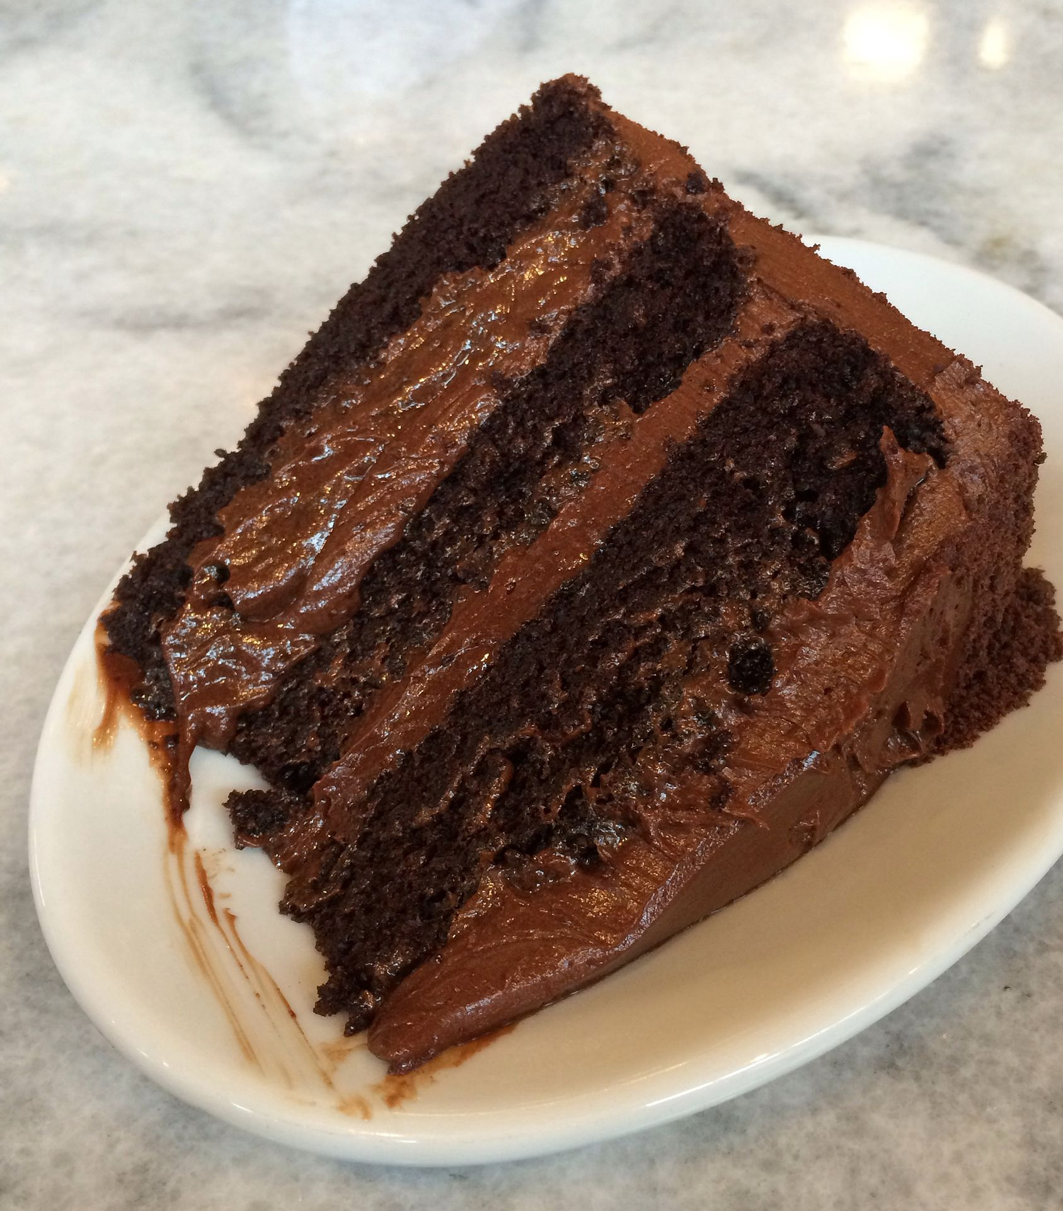
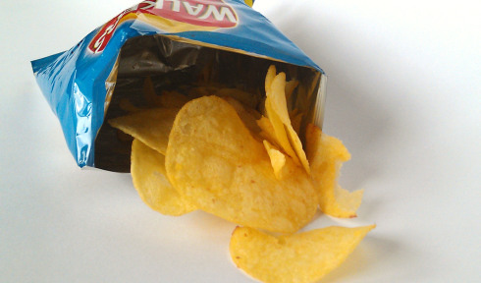
Things We Can
Give Up.

Slide 6
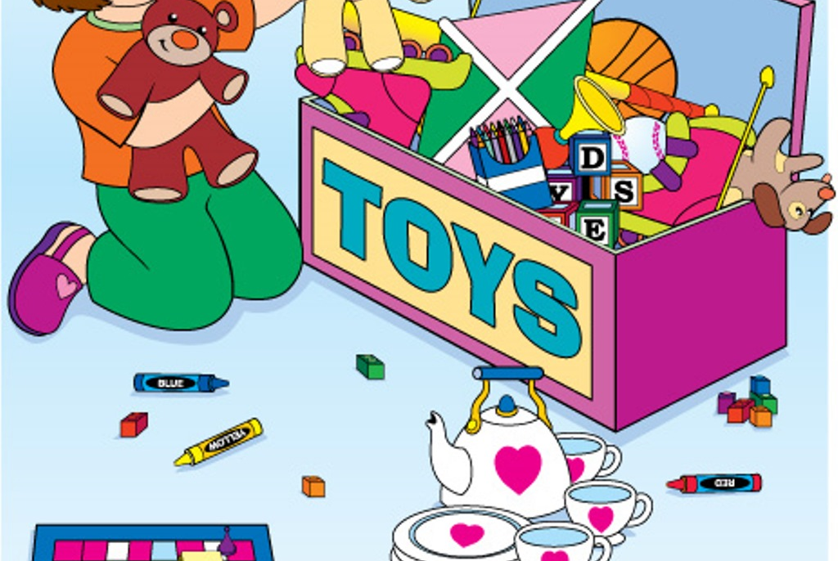
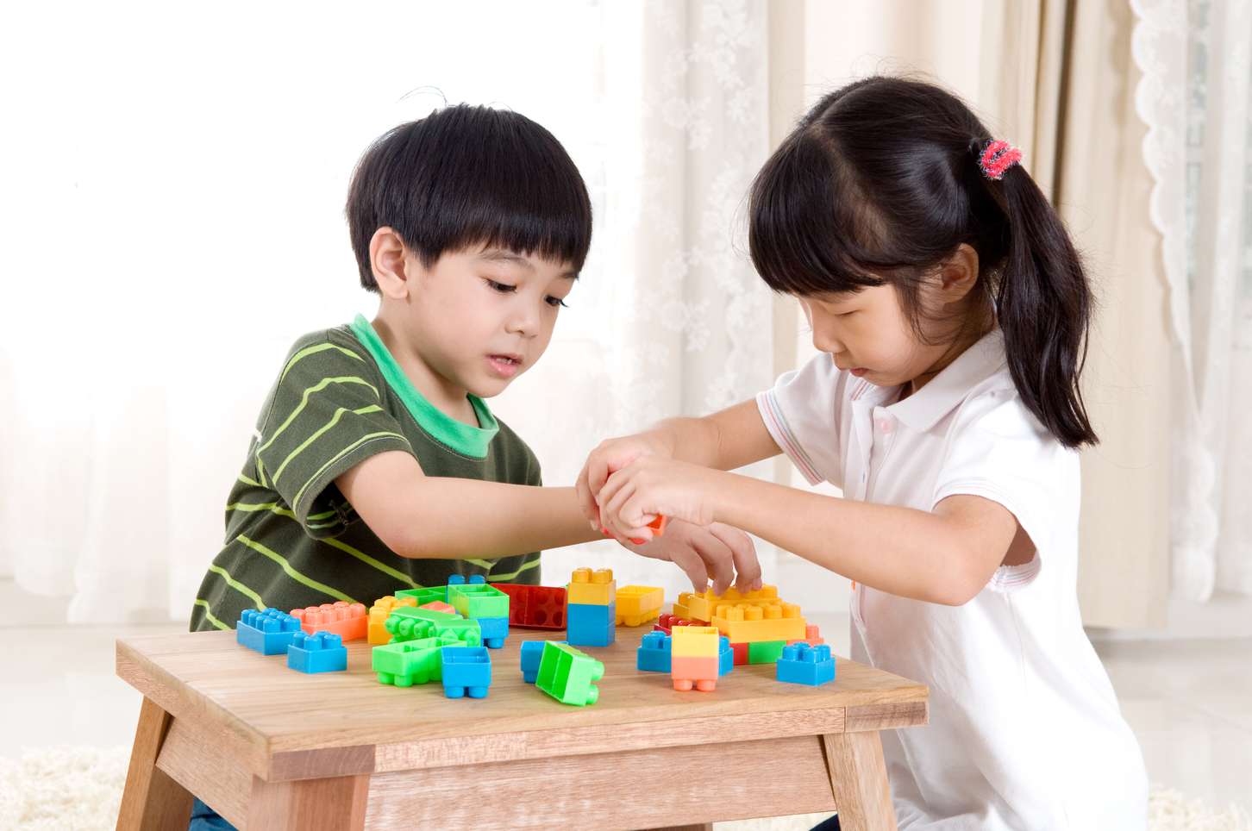
Ways I Can Help

Slide 7

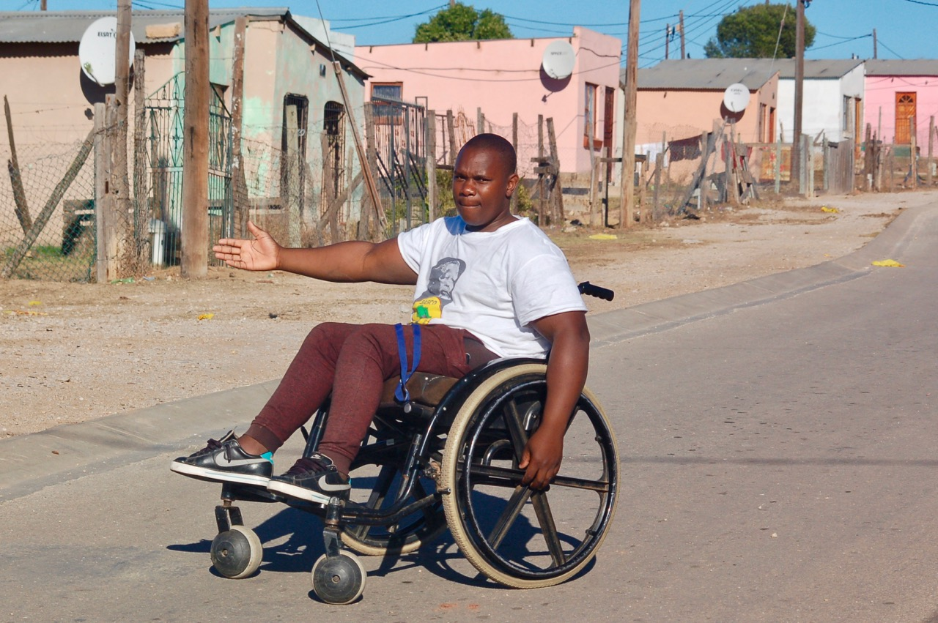
People I Han Help

Slide 8



Time to Pray.
When we pray, we begin with the sign of the Cross.
In the name of the Father
And of the Son
And of the Holy spirit, Amen.
God help me to be kind.
God, please help me to be good. Amen.

Slide 9
Do To Others
Do to others as you would have them do to you.
Say to others as you would have them say to you.
Think before you speak and act.
  We’re all God’s Children, that’s a fact,
  So do to others as you would have them do to you.
Walk a while in other’s shoes
It’s easy then to always choose
to do to others as you would have them do to you

Slide 10
Credits
Pictures
Creative Commons
Song
Do To Others
Maria Woodward and Damien Halloran
As One Voice for Kids
Willow Connection

