Slide 1
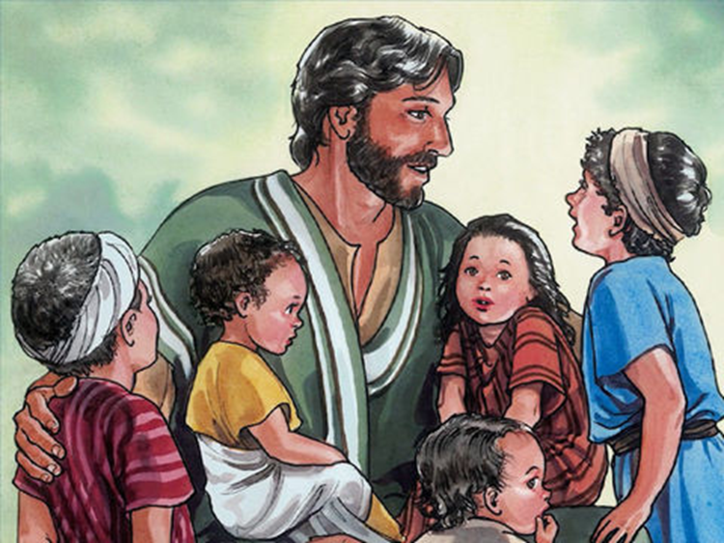

K.4.1 Jesus, God’s Son.
Jesus is a sign of God’s friendship in the world.

Slide 2
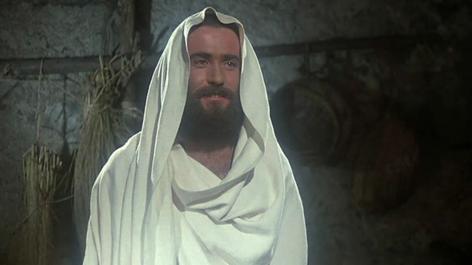

Time to Listen
God wants to be our friends. Because we cannot see God, it is hard for us to be His friend. God gives us many things because He loves us, and He wants us to know Him better. The greatest gift God has ever given us was His Son, Jesus. Being friends with Jesus is the best way to know God.
As Jesus grew up, He knew that God wanted Him to help people know how much God loved them. Jesus also showed us how to live as a good friend to others.

Slide 3

Jesus visited His friends in their homes. Jesus was very friendly to people who were sick or sad. He also told many stories to help his friends know how much God loved them.

Slide 4
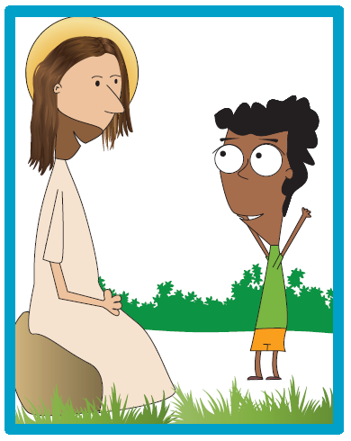
Student Workbook Activity
Page 17

Slide 5

We begin our prayer by making the Sign of the Cross.
In the name of the Father,
And of the Son,
And of the Holy Spirit, Amen.
Thank you God.

Slide 6
Friends
We have friends, quite a few;
Simon and Sarah just to name two.
Our best friend is your friend, too,
And His name is Jesus
Sometimes friends come to play
For a while they can stay.
One stays with us every day
And His name is Jesus
Friends don’t always see us through.
There’s not much we can do.
But one friend is always true,
And His name is Jesus
When we are the one to blame
We tell Jesus we are ashamed.
That’s how things get right again.
Yes , His name is Jesus

Slide 7
Credits
Friends
Hannah Digby
As One Voice for Kids
Pictures
Free Bible Images
Living Well Media
Creative Commons

