Slide 1
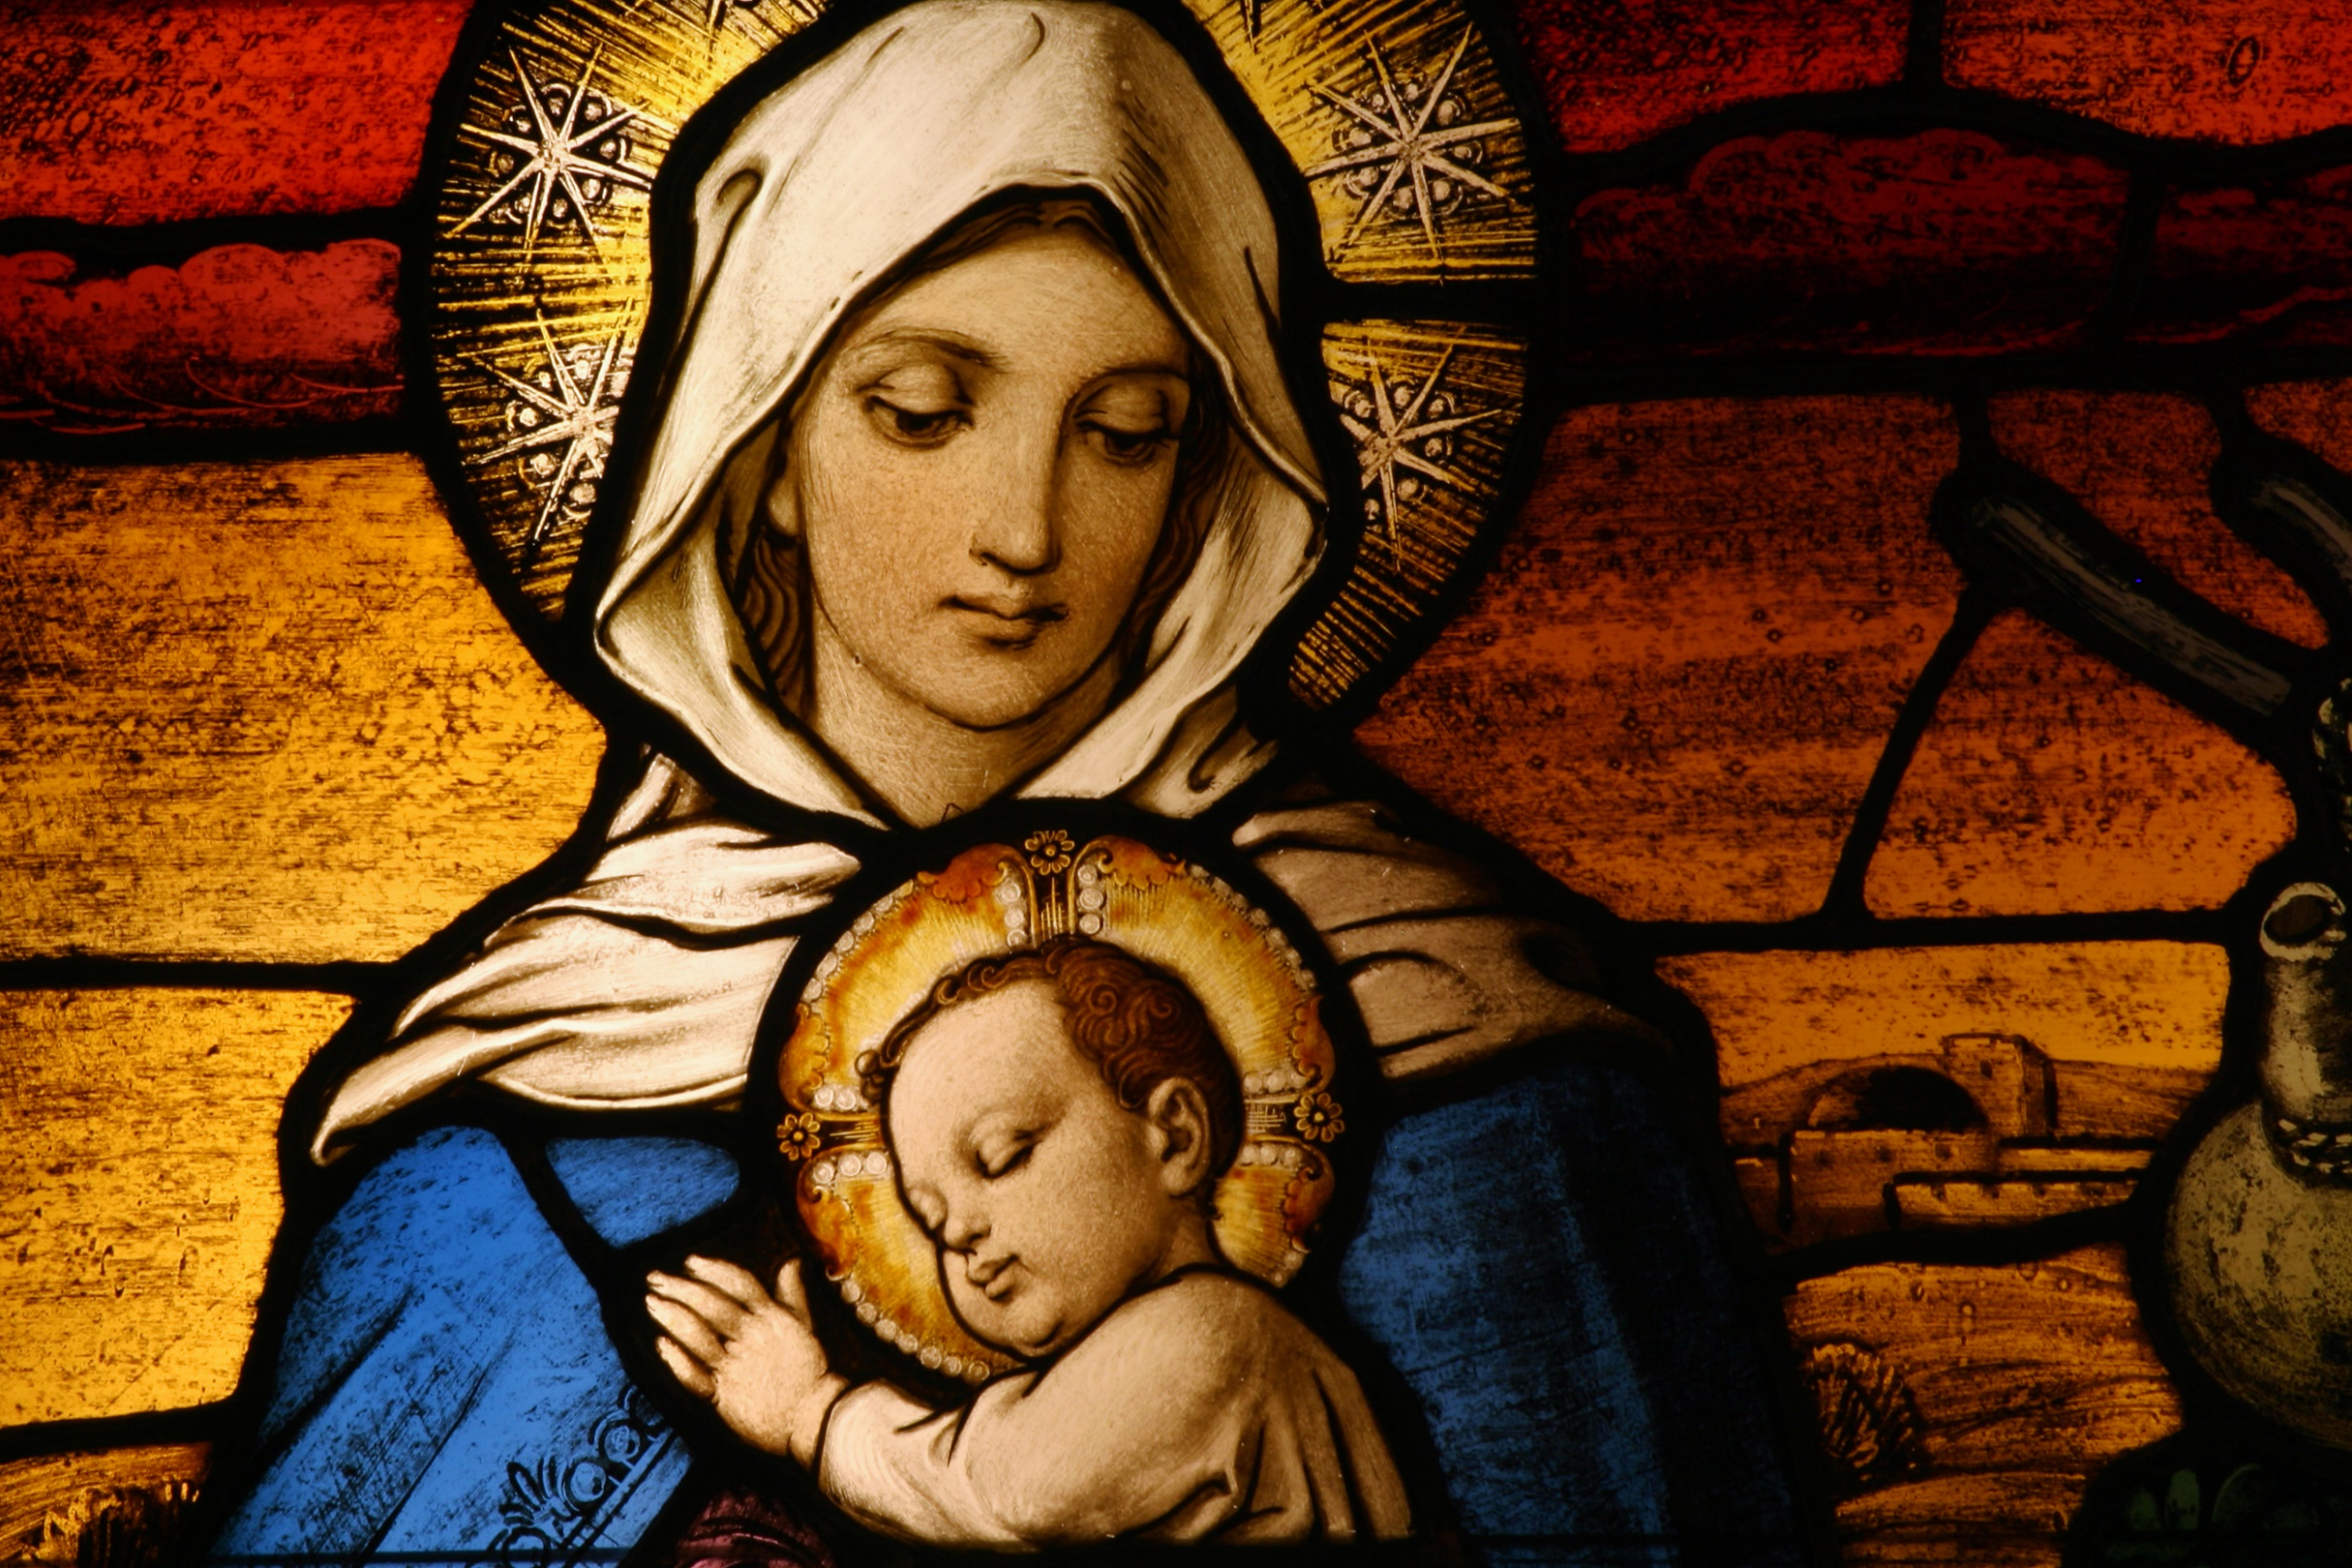

The model disciple
8.8.1

Slide 2
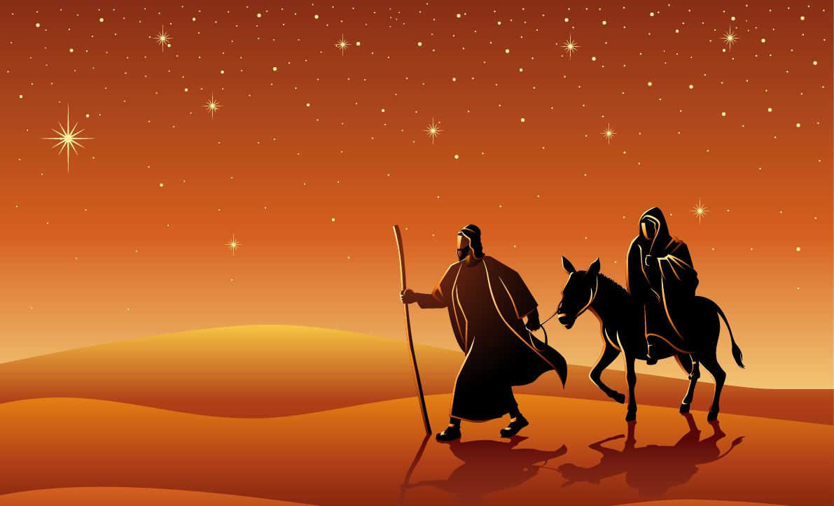

Magnificat
Stephen Kirk
Notes:
Slide will automatically transition at end of the video. 3.34

Slide 3

Images of Mary
Mother of God
The Mother of Jesus
Disciple of Jesus
Mother of the Church
Queen of Heaven
A praiser of God
A young woman fulfilling an ancient promise

Slide 4
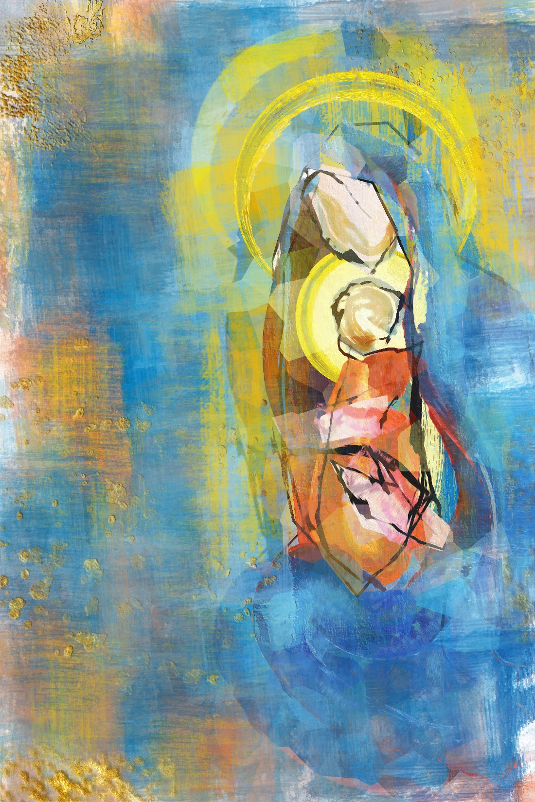
Mary in the Scriptures
Matthew 1:18-25 Joseph accepts Jesus
Luke 1:26-38 Announcement of birth
Luke 1:39-56 The visitation
Luke 2:1-21 The birth of Jesus
Luke 2:22-40 The presentation in the Temple
Luke 2: 41-52 Finding Jesus in the Temple
John 2:1-11 Marriage feast of Cana
John 19: 23-30 Mary at the foot of the Cross

Slide 5
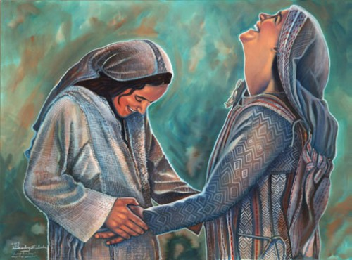
Magnificat

Slide 6
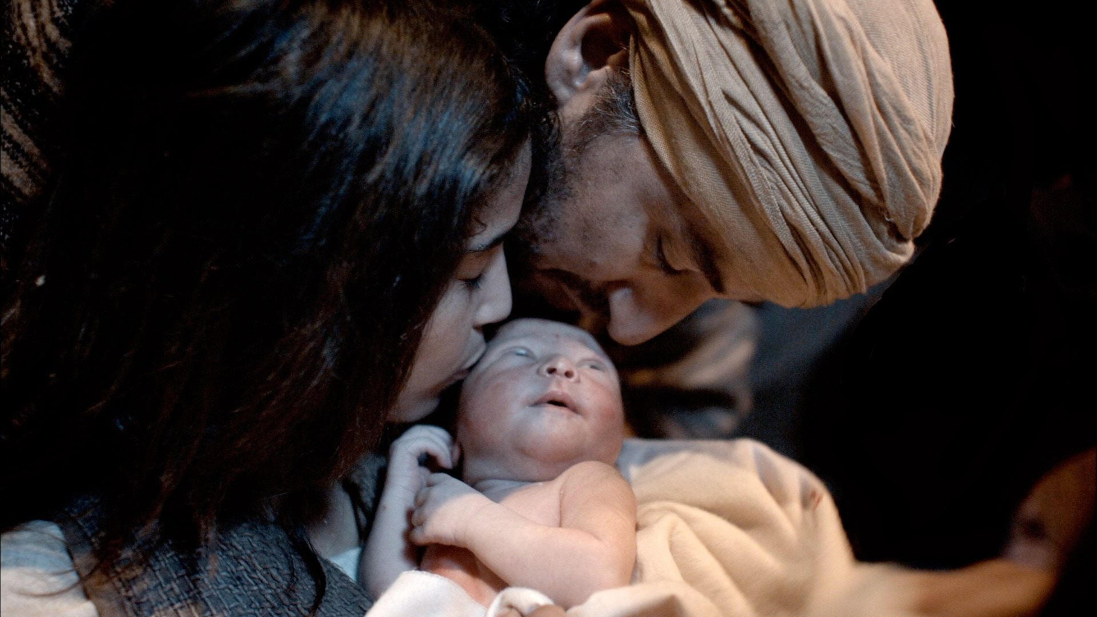
Birth of Jesus
in poverty

Slide 7
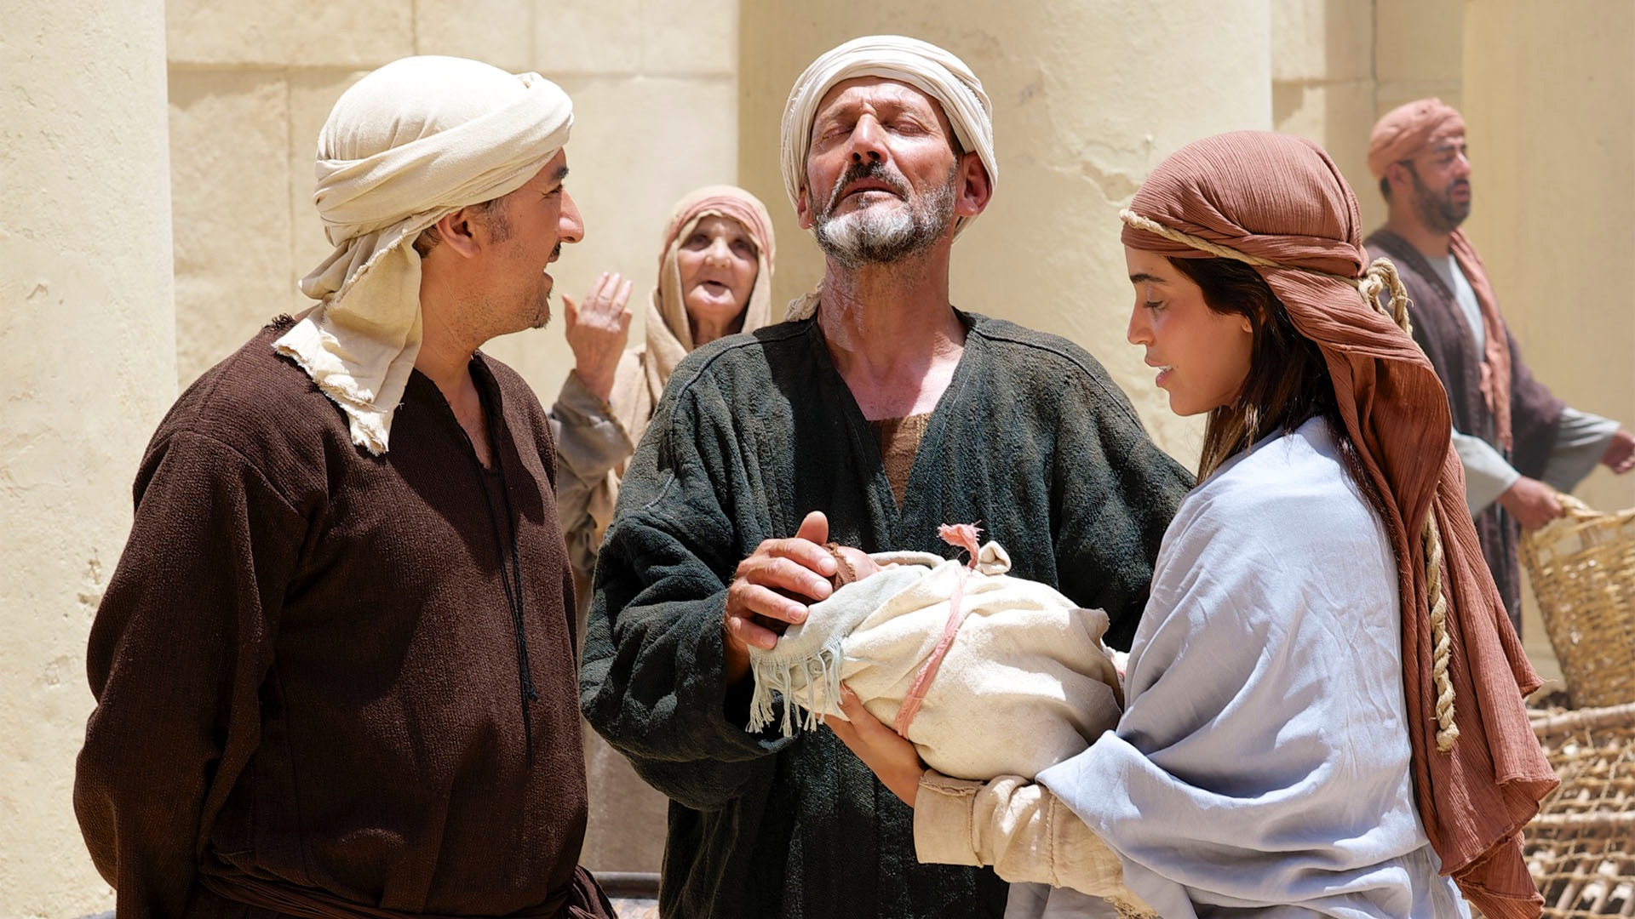
Mary with Jesus
in his childhood

Slide 8
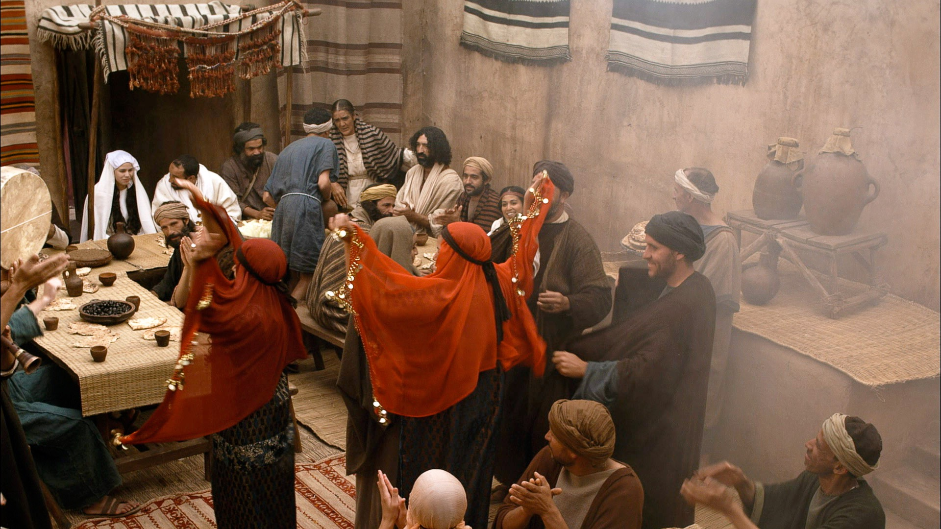
Wedding at Cana

Slide 9

Mary at the Cross

Slide 10
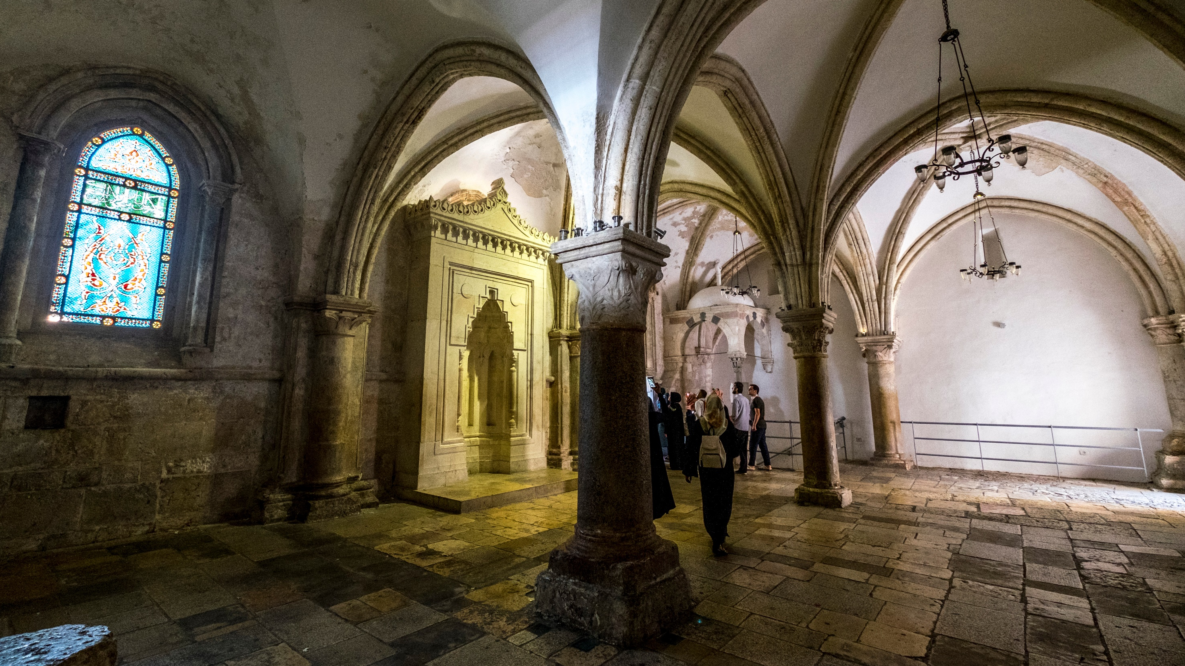
Praying in the Upper Room

Slide 11
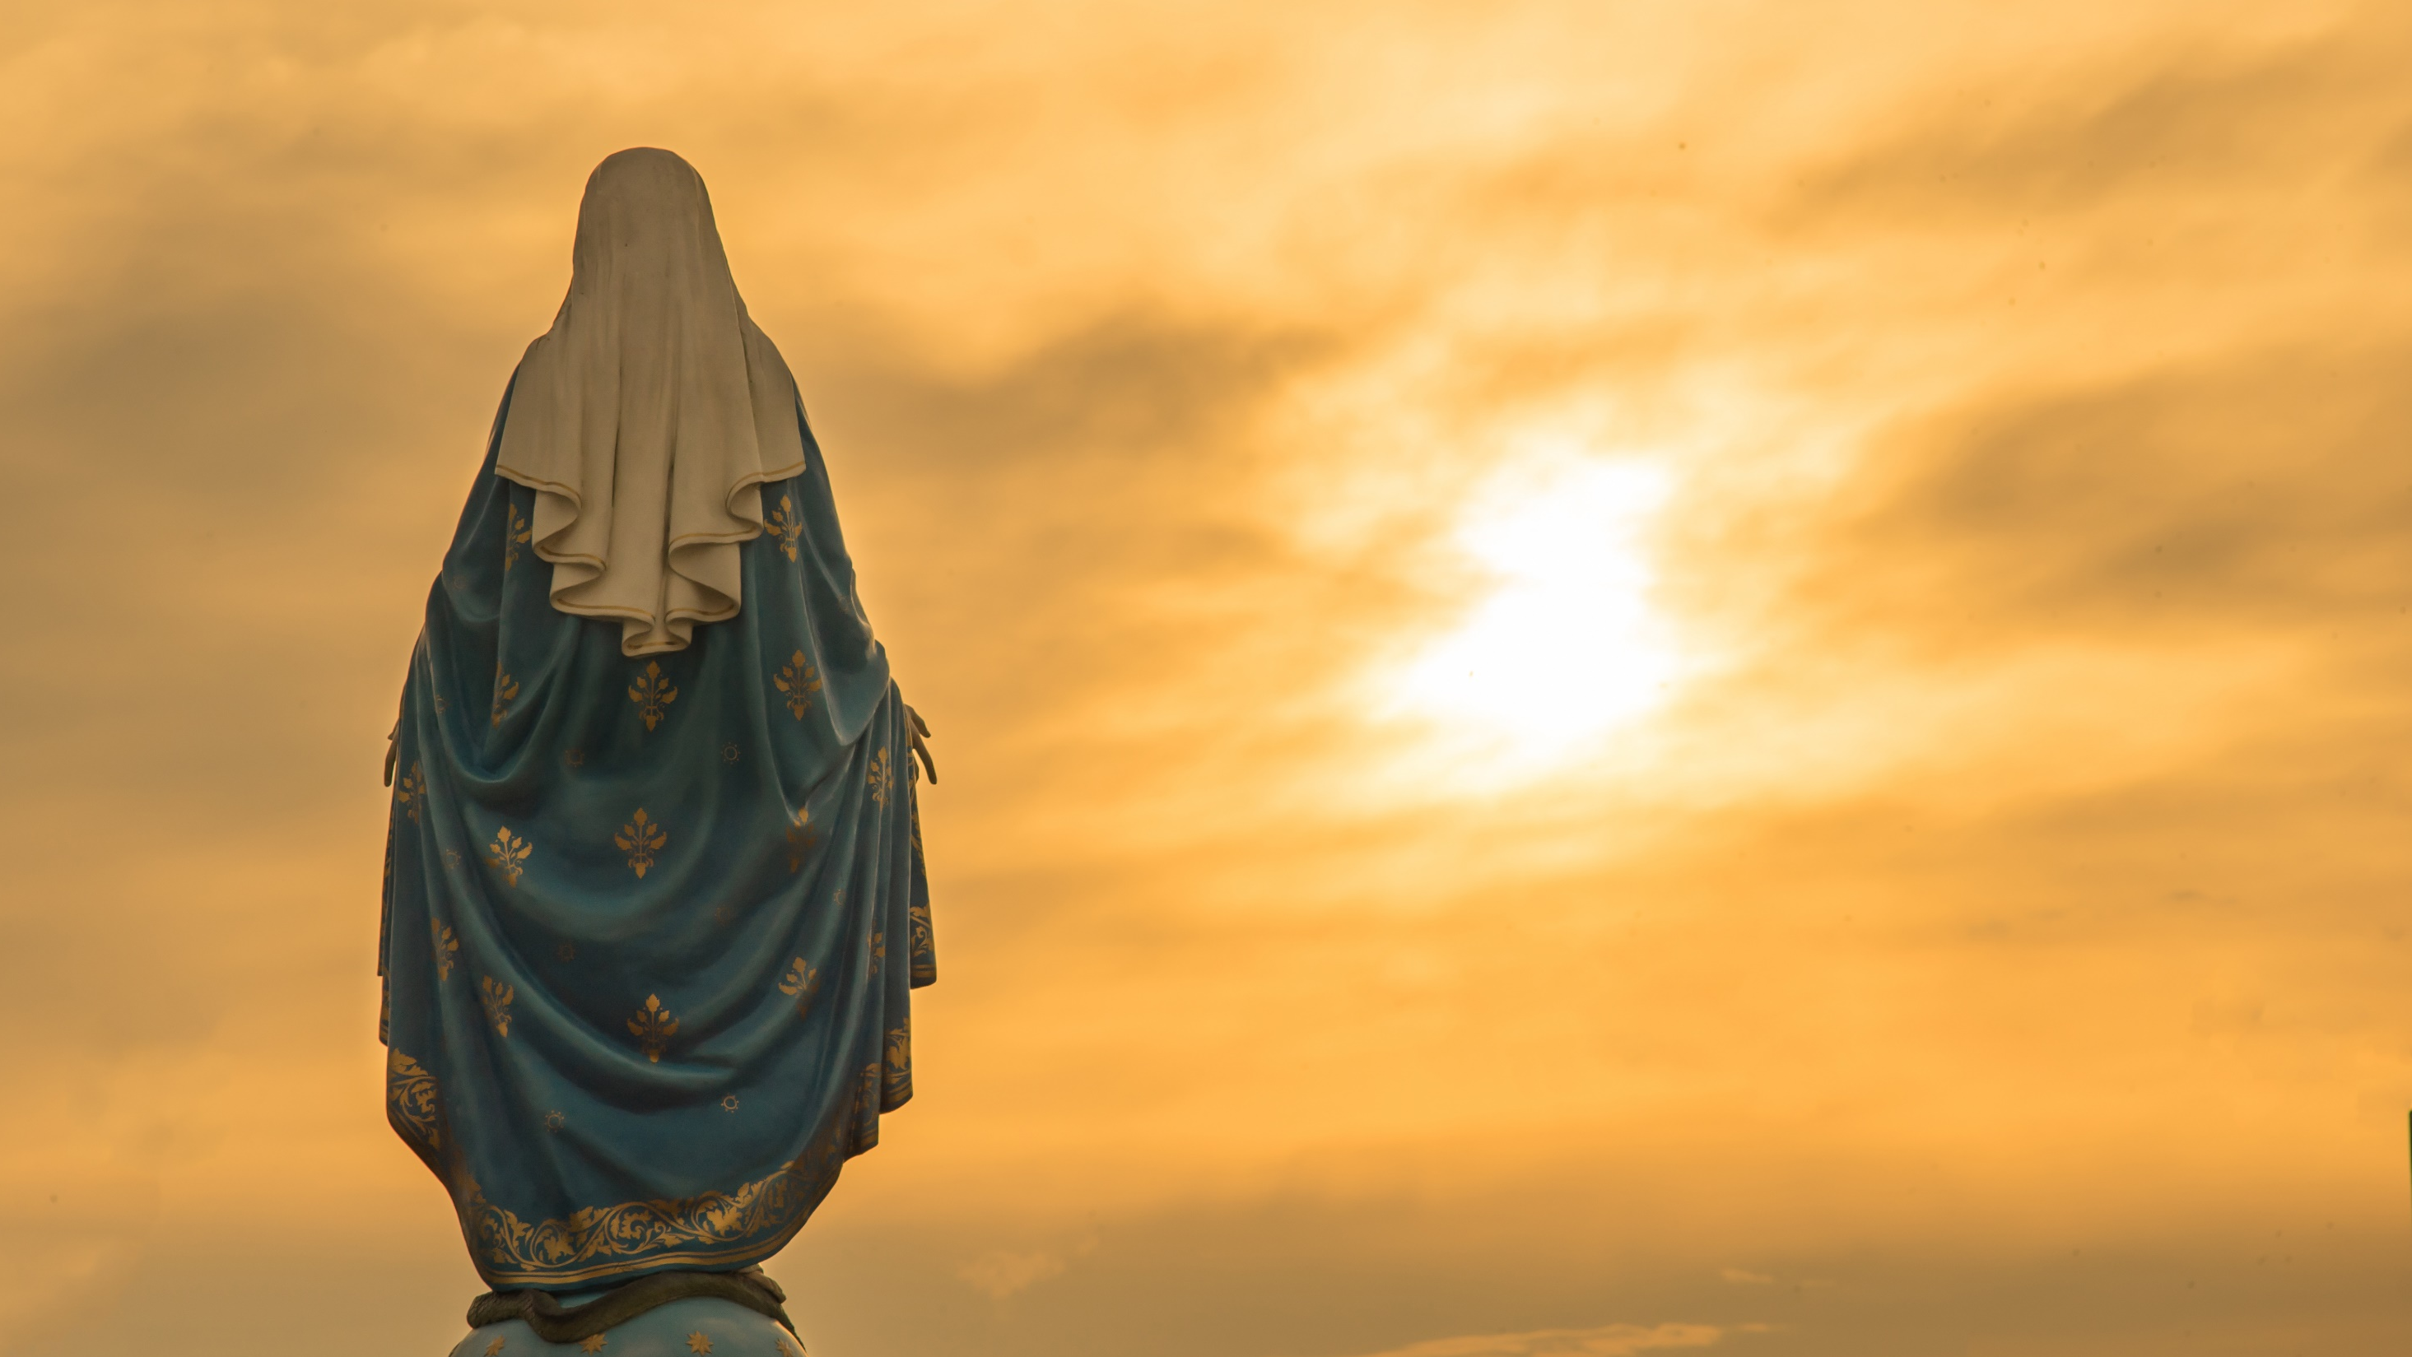
Mary, Queen of Heaven

Slide 12
Mary,
mother of God
- because Jesus is God
Mother of the Church

Slide 13
Hail Mary, full of grace,
the Lord is with you.
Blessed are you among women
and blessed is the fruit of your womb, Jesus.
Holy Mary, Mother of God,
pray for us sinners,
now and at the
hour of our death.
Amen.

Slide 14

Magnificat (Taizé)
Notes:
Slide will automatically transition at end of the video. 2.50

Slide 15

The Annunciation
In the sixth month, the angel Gabriel was sent from God to a town of Galilee called Nazareth, to a virgin betrothed to a man named Joseph, of the house of David, and the virgin’s name was Mary. And coming to her, he said, “Hail, favoured one! The Lord is with you. But she was greatly troubled at what was said and pondered what sort of greeting this might be. Then the angel said to her, “Do not be afraid, Mary, for you have found favour with God.. Behold, you will conceive in your womb and bear a son, and you shall name him Jesus. He will be great and will be called Son of the Most High, and the Lord God will give him the throne of David his father, and he will rule over the house of Jacob forever, and of his kingdom there will be no end.”
Luke 1:26-33

Slide 16
But Mary said to the angel, “How can this be, since I have no relations with a man?” And the angel said to her in reply, “The holy Spirit will come upon you, and the power of the Most High will overshadow you. Therefore the child to be born will be called holy, the Son of God.
And behold, Elizabeth, your relative, has also conceived a son in her old age, and this is the sixth month for her who was called barren; for nothing will be impossible for God.”
Mary said, “Behold, I am the handmaid of the Lord. May it be done to me according to your word.” Then the angel departed from her.
The Annunciation
Luke 1:34-38

Slide 17
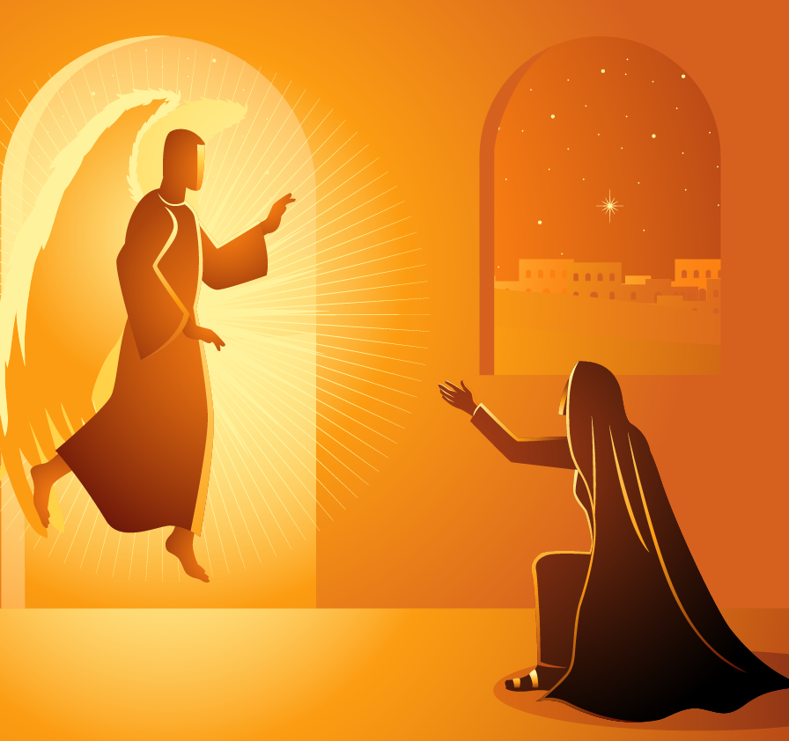
Concluding Prayer
Hail Mary, full of grace,
the Lord is with you.
Blessed are you among women and blessed is the fruit of your womb, Jesus.
Holy Mary, Mother of God,
pray for us sinners,
now and at the
hour of our death.
Amen

Slide 18
References
The Annunciation
https://www.bible.com/en-GB/videos/74-the-annunciation-mary-is-pregnant-from-lumoproject-dot-com
Used with permission under creative commons licence.
Song: Magnificat by Stephen Kirk. Used with permission under licence. All rights reserved.
Images: Vectors purchased from shutterstock.com. Used with permission under licence.
Photos taken from the lumoproject.com (via freebibleimages.org) –
Used with permission under creative commons licence.
Other images purchased from ignitermedia.com. Used with permission under licence.

