Slide 1



Slide 2
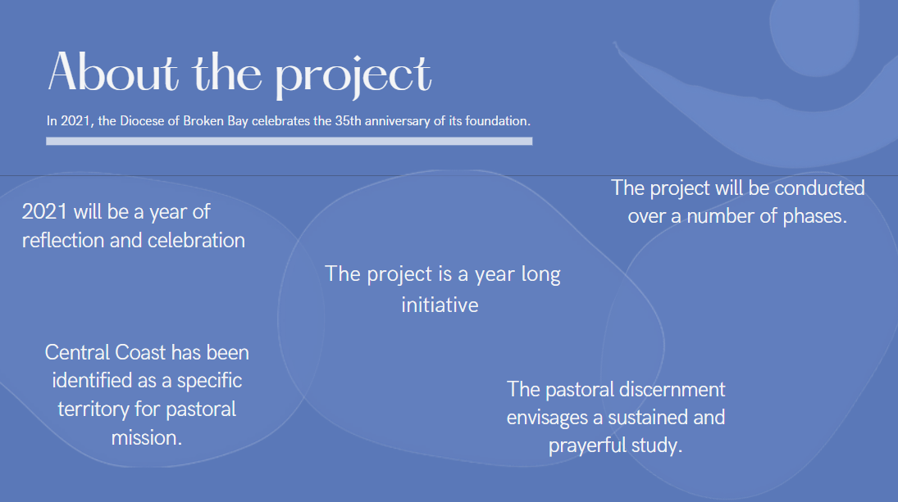

Slide 3
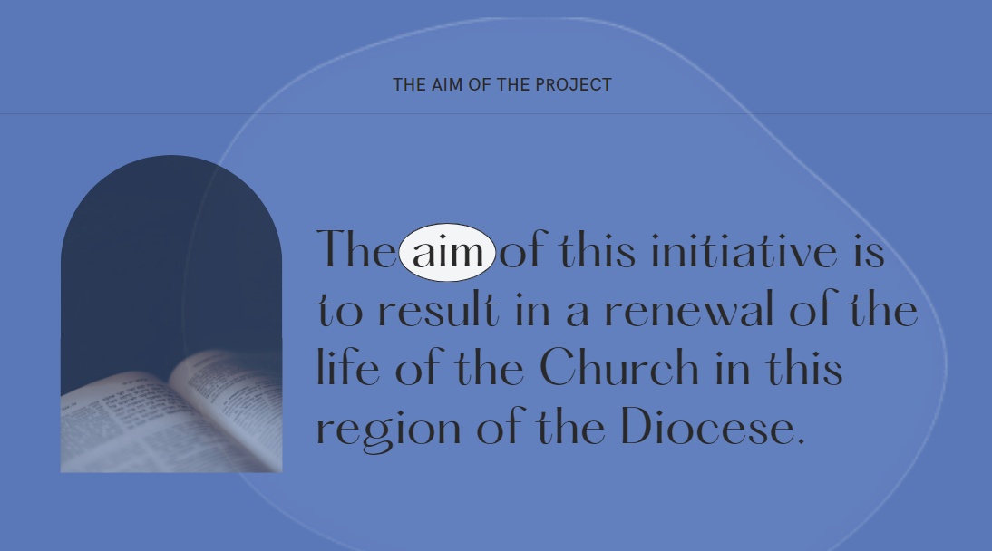

Slide 4
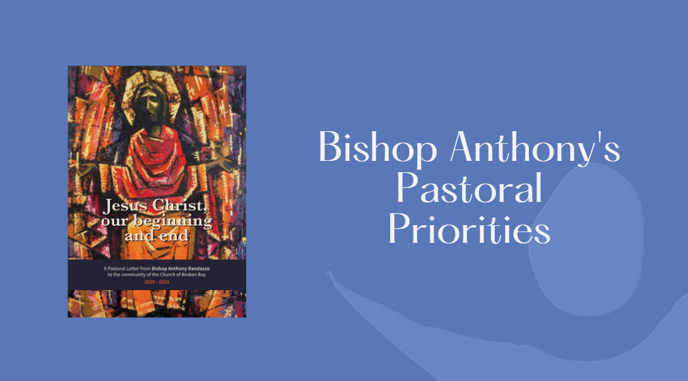
Notes:
The project aligns to Bishop Anthony’s 6 Pastoral Priorities as outlined in his letter to the community of the Church of Broken Bay 2020-2021
It can be accessed at https://www.bbcatholic.org.au/about/bishop/pastoral-letter-jesus-christ-our-beginning-and-end/pastoral-letter-jesus-christ-our-beginning-and-our-end

Slide 5
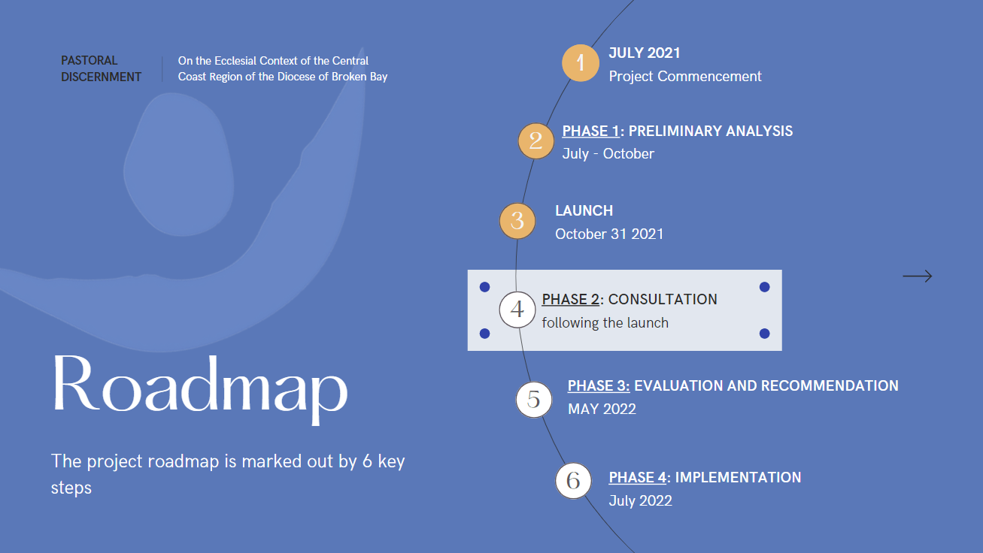
Notes:
Currently in phase 2 of the project – The consultation phase

Slide 6
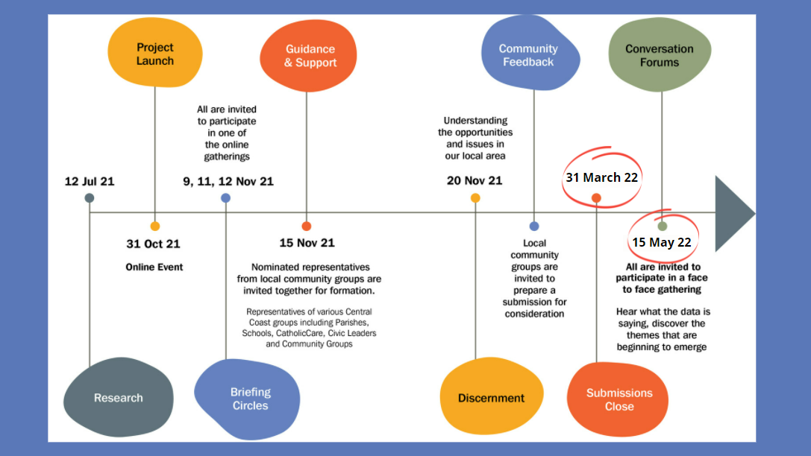
Notes:
NEW DATE! Submissions now close on 31 March 2022
The Pastoral Discernment Central Coast project timeline has been recalibrated to align with the dates of the General Synod and therefore the date for the closing of Submissions for the Central Coast project has been moved to 31 March. Conversation Forums have been re-scheduled for mid-May and further details about the forums will be provided in early 2022.

Slide 7
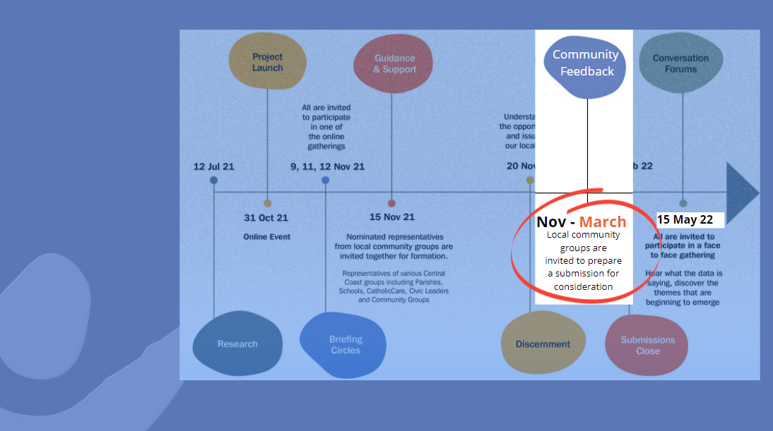
Notes:
Now at this part of the timeline of the consultation phase. – Community Feedback.
Between now and March – its time to gather our community feedback.
Listening and dialogue sessions to hear from the people of our community – at the service of shaping a Pastoral Discernment Submission for Bishop Anthony’s consideration.
Our listening and dialogue sessions are scheduled;
DATE: [insert detail]
TIME: [insert detail]
VENUE: [insert detail]
We invite all in our community to be part of our consultation journey.

Slide 8
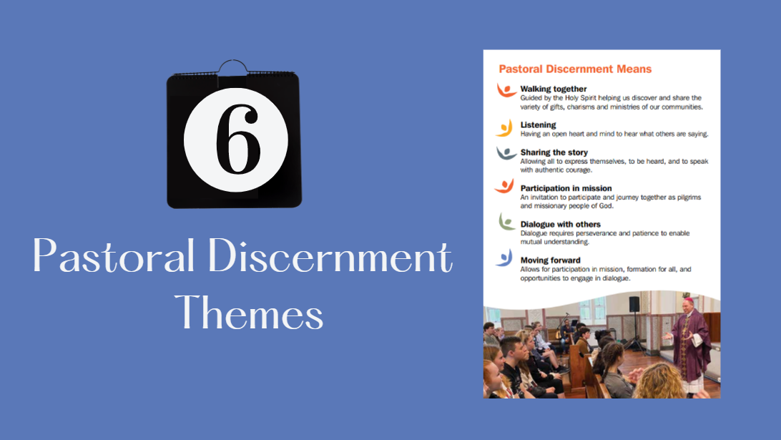
Notes:
The Pastoral Discernment project is underpinned by 6 themes; These themes provide opportunities for rich and engaging conversations.
Through the six themes … We are invited to walk together, guided by the Holy Spirit helping us to discover and share the variety of gifts amongst us. With an open heart and mind, listening to what others are saying, with the invitation for all to share their story, with courage.
We are invited to participate in mission as pilgrim people of God. Dialoguing with others to enable a mutual understanding so that we can all move forward together.
Guiding questions accompany each of the themes to be a helpful guide for our local discernment and dialogue.

Slide 9
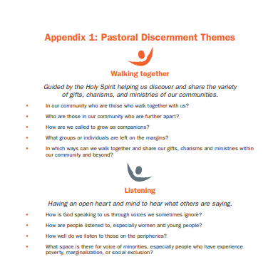
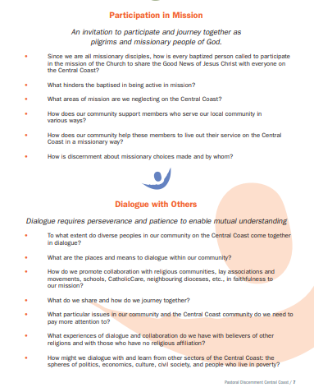
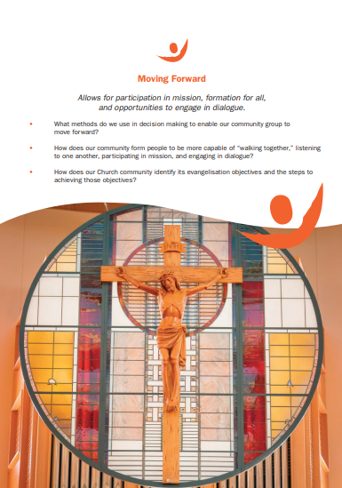
Pastoral Discernment Themes and
Guiding Questions
Notes:
The themes and guiding questions can be downloaded at https://www.bbcatholic.org.au/our-faith/pastoral-discernment-central-coast/community-resources.
You may want to print a few copies to hand out as Mass – or include a link in your parish bulletin / school newsletter
Visit the webpage to download https://www.bbcatholic.org.au/our-faith/pastoral-discernment-central-coast/community-resources

Slide 10
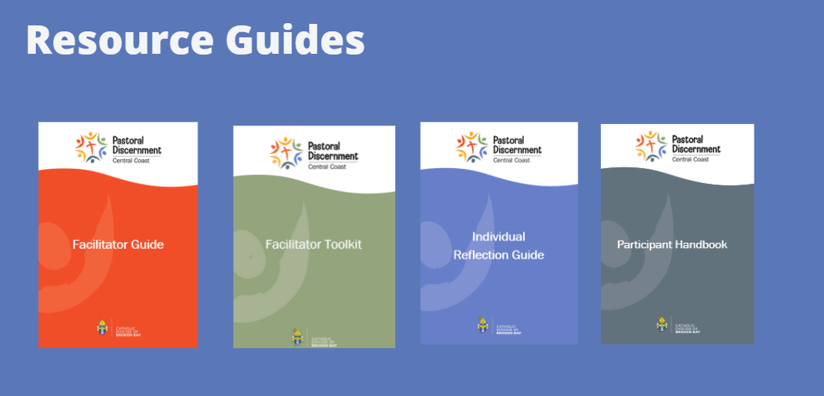
Notes:
The Pastoral Discernment Project resource support documents include; Facilitator Guide, Facilitator Handbook, Individual Reflection Guide, and a Participant Handbook. These can be accessed on the project webpage at https://www.bbcatholic.org.au/our-faith/pastoral-discernment-central-coast/community-resources

Slide 11
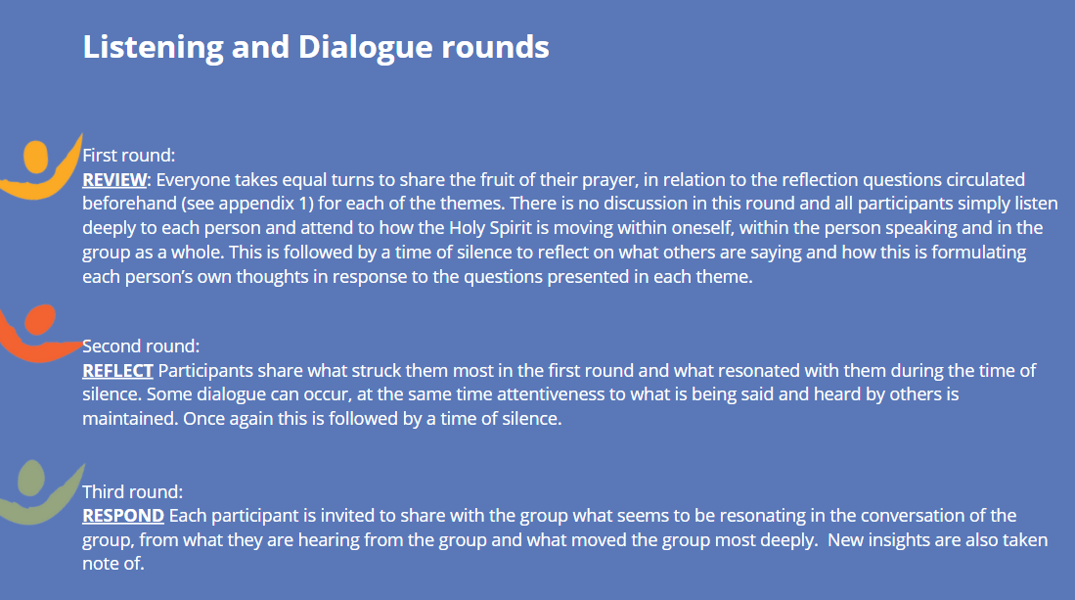
Notes:
The pastoral discernment invites each member of our community to REVIEW, REFLECT, RESPOND, considering the circumstances, opportunities and challenges to achieve a sustainable and thriving ecclesial community in the Central Coast region of the Diocese. Journeying forward together requires us to discern, as a community, our context through connection, prayer, reflection, sharing with one another and seeking God’s direction. We invite the Holy Spirit to guide us as we begin this journey.
For each of the themes, it is envisaged that we will participate in listening and dialogue rounds; and we will allow about 1 hour for each theme:
Step 1. Review round
Step 2. Reflect round; and
Step 3. Respond round

Slide 12
This page has been left blank – so that you can add specific details about your community consultation here
You may want to let you community know the following things.
Some ideas for consideration
Name of Parish / school Facilitator
Parish / school listening and dialogue session date and time
Theme/s chosen
Ways to get involved
How they can contact you as Facilitator; include phone number / Parish phone number / email address
Insert school / parish logo

