Slide 1



Pastoral Discernment
North Shore
DEANERY

Slide 2

These slides have been prepared as a guide, to assist communities in leading your Consultation Forum/s
Please adjust and amend to suit your context.
A holding slide has been included – as a guide and prompt, inviting a time of silent reflection after each round of conversation.
All questions have been included in this presentation – delete and adjust to suit your planning and your context.
NOTES are included in the ‘notes’ section of the PowerPoint

Slide 3


Slide 4
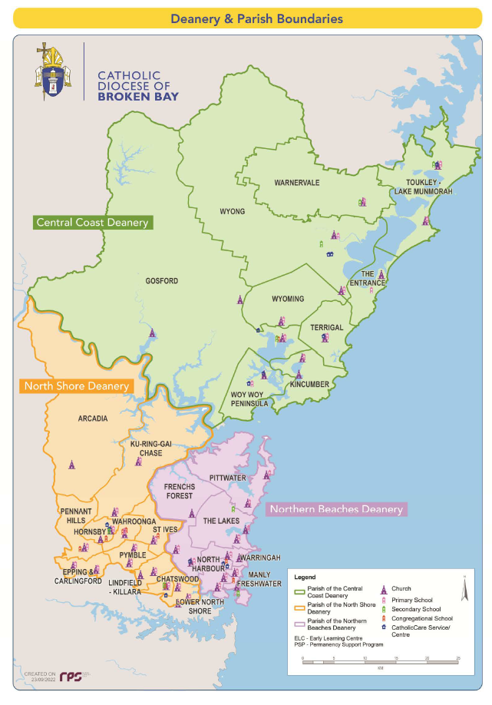
The Catholic Diocese of Broken Bay is divided up into three Deaneries
1: Central Coast Deanery
2: Northern Beaches Deanery
3: North Shore Deanery

Slide 5
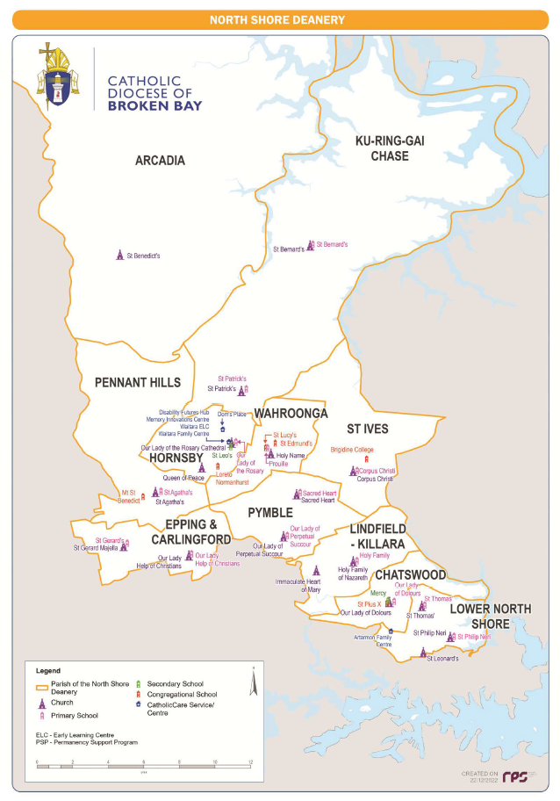

North Shore Deanery

Slide 6
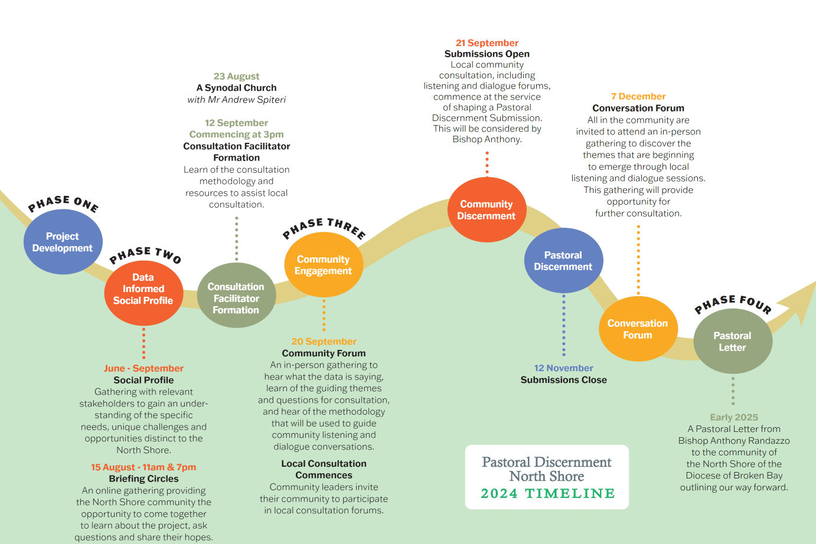

As we journey forward
together

Slide 7
Adsumus Sancte Spiritus
We stand before you, Holy Spirit, as we gather together in Your name.
With You alone to guide us, make Yourself at home in our hearts;
Teach us the way we must go and how we are to pursue it.
We are weak and sinful; do not let us promote disorder.
Do not let ignorance lead us down the wrong path nor partiality
influence our actions.
Let us find in You our unity so that we may journey together
to eternal life and not stray from the way of truth and what is right.
All this we ask of You, who are at work in every place and time,
in the communion of the Father and the Son,
forever and ever.
AMEN

Slide 8



Consultation Forum
Five-Step Process
1
Pray together
2
Time to Reflect
Round
1
Round
2
Round
3
3
Share and Listen
4
Group Response
5
Pray and Respond

Slide 9

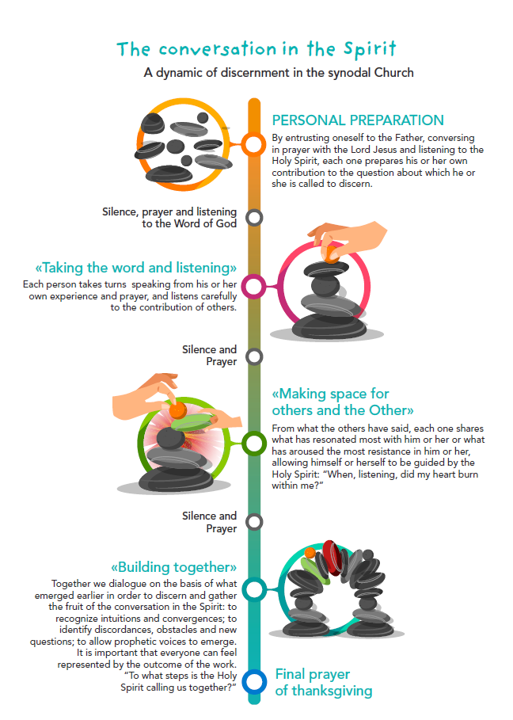
Conversation in the Spirit
Integrates active listening, intentional speaking, moments of silence and respect for each participant’s input.
Round
1
Round
2
Round
3

Slide 10

Conversation in the Spirit
Integrates active listening, intentional speaking, moments of silence and respect for each participant’s input.
I
YOU
Round
1
Round
2
Round
3
WE

Slide 11
Notes:
A copy of this resource can be downloaded as a one-page document at;
https://www.bbcatholic.org.au/mission/pastoral-discernment-north-shore/consultation-resources/consultation-resources

Slide 12

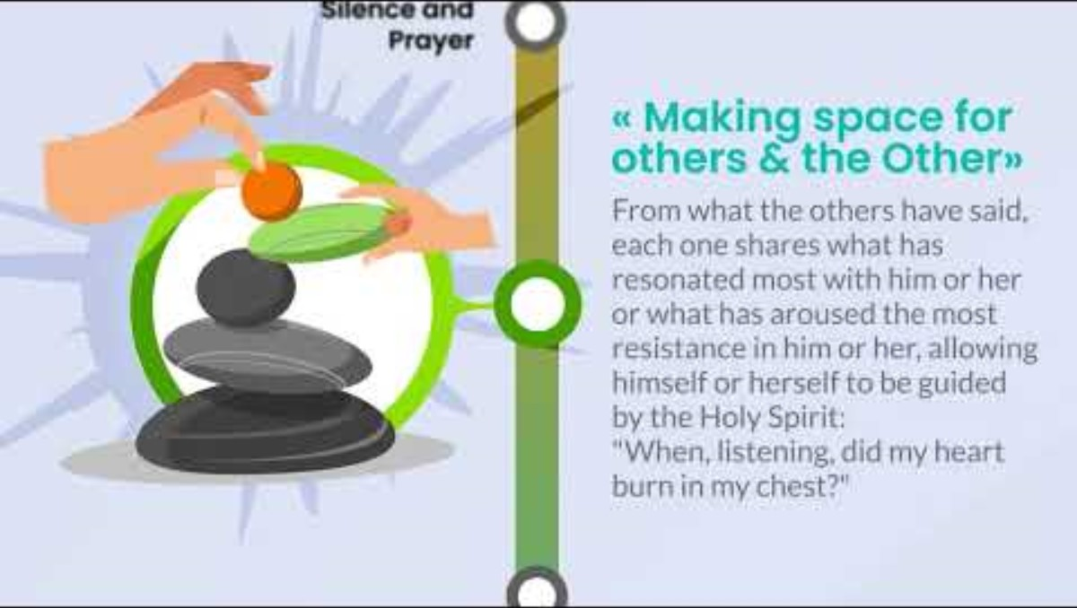
Conversation in the Spirit
Notes:
This video link can be accessed at;
https://www.bbcatholic.org.au/mission/pastoral-discernment-north-shore/videos

Slide 13
Conversation in the Spirit
First Round
Second Round
Third Round
What have
I
discerned?
What did I hear YOU
say that struck me?
In what direction are
WE
being led by the Spirit?

Slide 14

Round 1: Sharing my reflection
  Everyone takes equal turns to share
  Each person begins with “In my prayer....”
  Allow 1-2 minutes of sharing per person
  There is no discussion and no response
  Once everyone at the small table has shared the fruits of their prayer, there will be 1 minute for silence before moving to round 2

Slide 15
Round 2: Reflecting on the sharing
  Participants share what struck them the most, what resonated during the time of silence.
  Everyone takes equal turns to share, 1 minute
  Once again there is no discussion or responses to the conversation.
  Respond to questions like:
      How was I affected by what I heard?
      Is there a comment or thread that is shared?
      Have I received any particular insight?
      Where did I experience a sense of harmony in what I was hearing from others?
      What am I feeling now?

Slide 16
Round 3 : What is the group saying?
  Participants are not obliged to speak and can speak spontaneously.
  Participants are invited to share what seems to be resonating in the conversation from the group.
  What shared discernment has emerged? Where is the Holy Spirit calling us to go?
  Approx 10 minutes of small group conversation.

Slide 17

GROUP RSPONSE
After ROUND 3 - the table scribe works with the group to complete the Small Group Conversation Summary report.
Each small group is invited to share - in 1 minute - the fruits of the small group conversation.
and then

Slide 18
Role of the....
Table Facilitator
  Make everyone feel welcome
  Invite participation
  Keep an eye on time
  Create the opportunity to listen to the Holy Spirit
  Encourage listening and dialogue
  Create an environment of openness
  Observe times of silence and prompt when necessary
  Be mindful of what this is not...
  A time of debating, defending, arguing
  Correcting others
  Feeling obliged to teach others, even if well-intended
  Advancing an agenda
  A search for the one right answer

Slide 19
Role of the....
Table Scribe
DURING: Takes notes of what everyone is saying
FOLLOWING: work with the table facilitator and ALL at the table to
synthesise the fruits of the conversation.
There will be time allocated following the three rounds to work with the group to write the table summary report.

Slide 20

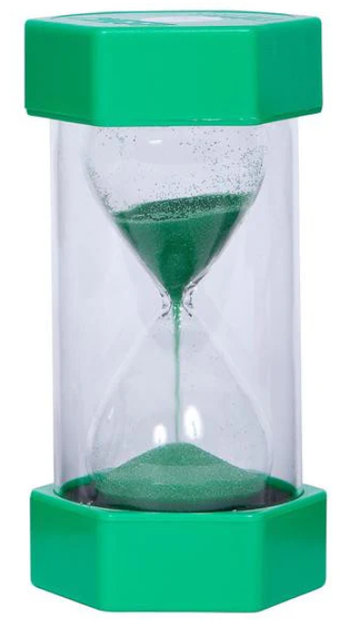
On your table

Slide 21

Step 1
PRAY TOGETHER
INSERT PRAYER HERE

Slide 22
Step 2
TIME TO REFLECT
Allow time for silent reflection

Slide 23

Notes:
Allow time for silence between each round – approx. 1 minute

Slide 24

Step 3
SHARE AND LISTEN
QUESTION 1: The data highlights a clear and significant decline in participation in the pastoral and sacramental life of our communities. How does this shift impact our sense of identity and mission within our local communities? What resourcing initiatives or areas of mission should be considered to address this decline in Catholic identification in the North Shore Deanery?

Slide 25



Round 1
What have
I
discerned?
TIME REMAINING
Notes:
Click on the red play button - with 5 minutes remaining of round 1.
The timing will be dependent on;
1: How many people are at each small table
2: Whether you’ve planned for and allowed 1 or 2 minutes per person to speak.

Slide 26
Notes:
Allow time for silence between each round

Slide 27
ROUND 2
What did I hear
YOU
say that
struck me?
TIME REMAINING
Notes:
Click on the red play button - with 5 minutes remaining of round 2.
The timing will be dependent on;
1: How many people are at each small table
2: Whether you’ve planned for and allowed 1 or 2 minutes per person to speak.

Slide 28
Notes:
Allow time for silence between each round

Slide 29


ROUND 3
Round 3
In what direction are
WE
being led by the Spirit?
What have
I
discerned?
TIME REMAINING
Notes:
Click on the red play button - with 10 minutes remaining of round 3.

Slide 30
Notes:
Allow time for silence between each round

Slide 31
Step 3
SHARE AND LISTEN
QUESTION 2: What pastoral synergies exist across our North Shore Deanery? How might clusters of parish communities collaborate more effectively? What may be possible across our cluster of parishes in our Deanery?

Slide 32
Round 1
What have
I
discerned?
TIME REMAINING
Notes:
Click on the red play button - with 5 minutes remaining of round 1.
The timing will be dependent on;
1: How many people are at each small table
2: Whether you’ve planned for and allowed 1 or 2 minutes per person to speak.

Slide 33
Notes:
Allow time for silence between each round

Slide 34
ROUND 2
What did I hear
YOU
say that
struck me?
TIME REMAINING
Notes:
Click on the red play button - with 5 minutes remaining of round 2.
The timing will be dependent on;
1: How many people are at each small table
2: Whether you’ve planned for and allowed 1 or 2 minutes per person to speak.

Slide 35
Notes:
Allow time for silence between each round

Slide 36
ROUND 3
Round 3
In what direction are
WE
being led by the Spirit?
What have
I
discerned?
TIME REMAINING

Slide 37
Notes:
Allow time for silence between each round

Slide 38
Step 3
SHARE AND LISTEN
QUESTION 3: What do you consider to be the most pressing issues for people living in the North Shore Deanery and how best might parish communities respond to these?

Slide 39
Round 1
What have
I
discerned?
TIME REMAINING
Notes:
Click on the red play button - with 5 minutes remaining of round 1.
The timing will be dependent on;
1: How many people are at each small table
2: Whether you’ve planned for and allowed 1 or 2 minutes per person to speak.

Slide 40
Notes:
Allow time for silence between each round

Slide 41
ROUND 2
What did I hear
YOU
say that
struck me?
TIME REMAINING
Notes:
Click on the red play button - with 5 minutes remaining of round 2.
The timing will be dependent on;
1: How many people are at each small table
2: Whether you’ve planned for and allowed 1 or 2 minutes per person to speak.

Slide 42
Notes:
Allow time for silence between each round

Slide 43
ROUND 3
Round 3
In what direction are
WE
being led by the Spirit?
What have
I
discerned?
TIME REMAINING

Slide 44
Notes:
Allow time for silence between each round

Slide 45
Step 3
SHARE AND LISTEN
QUESTION 4: The data highlights an increasing demand and stress on community members due to high living costs and housing distress. How can the Church’s pastoral mission be adapted to address these challenges? What specific pastoral initiatives can the Church implement to support individuals and families facing financial hardship? What areas for outreach may need to be thought through and considered?

Slide 46
Round 1
What have
I
discerned?
TIME REMAINING
Notes:
Click on the red play button - with 5 minutes remaining of round 1.
The timing will be dependent on;
1: How many people are at each small table
2: Whether you’ve planned for and allowed 1 or 2 minutes per person to speak.

Slide 47
Notes:
Allow time for silence between each round

Slide 48
ROUND 2
What did I hear
YOU
say that
struck me?
TIME REMAINING
Notes:
Click on the red play button - with 5 minutes remaining of round 2.
The timing will be dependent on;
1: How many people are at each small table
2: Whether you’ve planned for and allowed 1 or 2 minutes per person to speak.

Slide 49
Notes:
Allow time for silence between each round

Slide 50
ROUND 3
Round 3
In what direction are
WE
being led by the Spirit?
What have
I
discerned?
TIME REMAINING

Slide 51
Notes:
Allow time for silence between each round

Slide 52
Step 3
SHARE AND LISTEN
QUESTION 5: How does the current configuration of Catholic Communities on the North Shore facilitate or limit mission, ministry, worship, liturgy, and catechesis? What may need to be considered or reviewed to enhance and strengthen Catholic Communities on the North Shore?

Slide 53
Round 1
What have
I
discerned?
TIME REMAINING
Notes:
Click on the red play button - with 5 minutes remaining of round 1.
The timing will be dependent on;
1: How many people are at each small table
2: Whether you’ve planned for and allowed 1 or 2 minutes per person to speak.

Slide 54
Notes:
Allow time for silence between each round

Slide 55
ROUND 2
What did I hear
YOU
say that
struck me?
TIME REMAINING
Notes:
Click on the red play button - with 5 minutes remaining of round 2.
The timing will be dependent on;
1: How many people are at each small table
2: Whether you’ve planned for and allowed 1 or 2 minutes per person to speak.

Slide 56
Notes:
Allow time for silence between each round

Slide 57
ROUND 3
Round 3
In what direction are
WE
being led by the Spirit?
What have
I
discerned?
TIME REMAINING

Slide 58
Notes:
Allow time for silence between each round

Slide 59



STEP 4:
Gathering the fruits of our small group conversation
Notes:
The table scribe works with the small table to complete the Small Group Conversation Summary Report.

Slide 60

?
TIME REMAINING

Slide 61
Notes:
Allow time for silence between each round

Slide 62
Creator God, we thank you for the encounter with one another today. We know that where two or three are gathered, you are in our midst.
Thank you for being with us,
for the opportunities to speak broadly and passionately and for the humility to listen to each other with open hearts.
We ask you to continue to walk with us, as we discover together the pathway forward, toward the future for the North Shore, and the future that You are calling us to.
Amen.

Slide 63
Thank you

